Slide 1
Quantitative trait locus mapping in multiparent crosses
Daniel Gatti, Ph.D
Feb. 13, 2018

Slide 2
Outline
Laboratory mice
Quantitative Trait Locus (QTL) mapping in two parent crosses
QTL mapping in eight parent crosses
Genotyping
Mapping
QTL mapping example
Benzene toxicity

Slide 3
Outline
Laboratory mice
QTL mapping in two parent crosses
QTL mapping in eight parent crosses
Genotyping
Mapping
Diversity Outbred QTL mapping example
Benzene toxicity

Slide 4
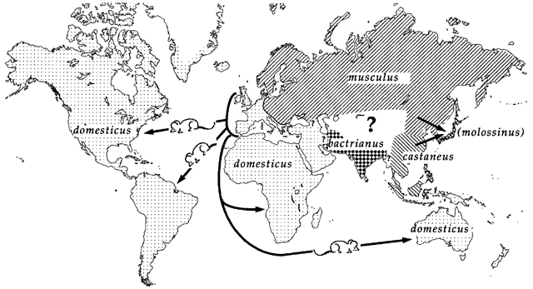
Laboratory mice descend from several parts of the world
Silver, Bonhomme

Slide 5
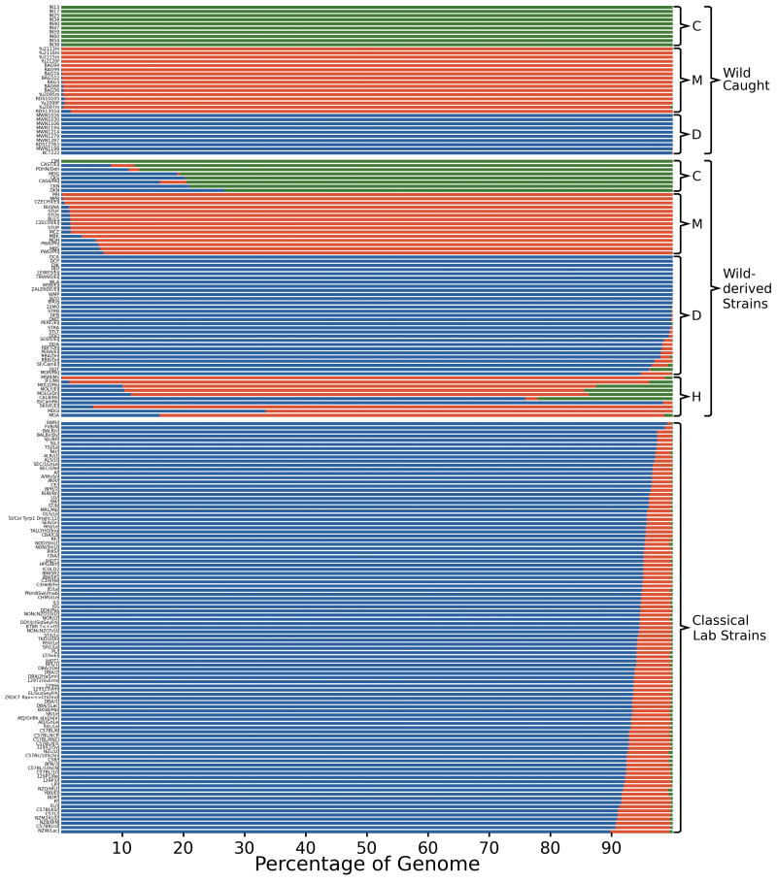
Classical inbred strains have limited genetic diversity
M.m. domesticus
M.m. musculus
Wild Caught Mice
M.m. castaneus
Wild Derived Inbred Strains
Classical Inbred Lab Strains
Yang et.at., Nat. Gen. 2011

Slide 6
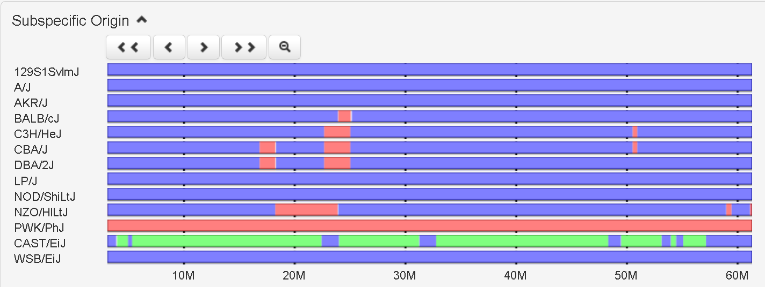
Mouse Phylogeny Viewer shows you genetic diversity between mouse strains
http://msub.csbio.unc.edu/
Chr 19
M.m. domesticus
M.m. musculus
M.m. castaneus
Jeremy R. Wang, Fernando Pardo-Manuel de Villena, & Leonard McMillan. Comparative analysis and visualization of multiple collinear genomes. BMC Bioinformatics, 2012.
Notes:
If you want to make a cross from two strains are genetically diverse on Chr 19 at 20 Mb, which two would you select?

Slide 7
Laboratory mice are usually Inbred
Brother/sister mating for more than 20 generations.
Breed until mice are homozygous at most loci.
All members of an inbred strain have identical genetic composition.
Fixes phenotypes in each strain for further study.
The Jackson Laboratory has hundreds of inbred strains. http://jaxmice.jax.org/
Many have been phenotyped: http://phenome.jax.org

Slide 8
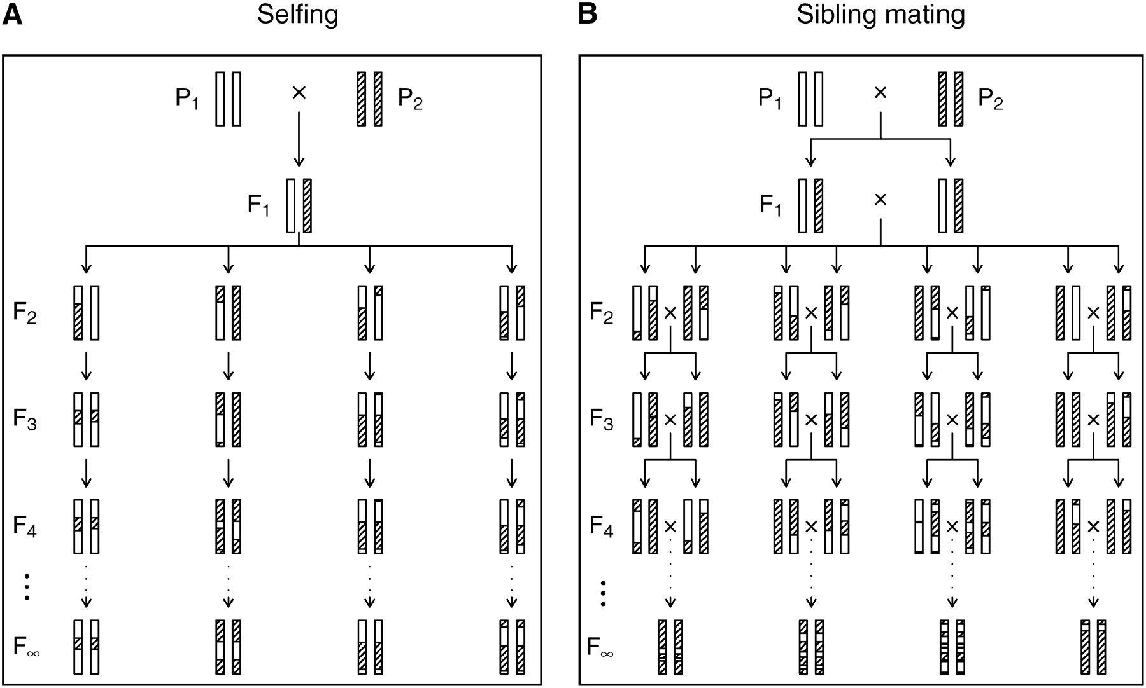
The production of recombinant inbred lines by selfing (A) and by sibling mating (B).
Karl W. Broman Genetics 2005;169:1133-1146

Slide 9
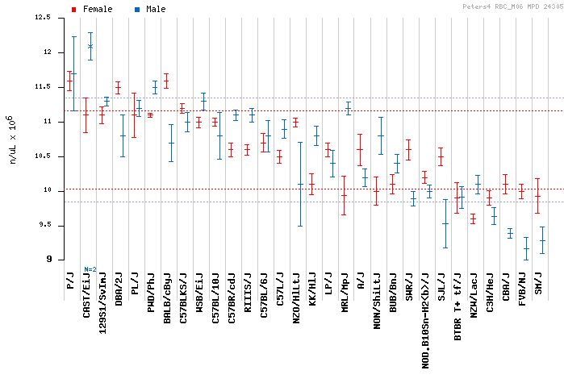
Red Blood Cell (RBC) counts
Notes:
Do males or females have higher RBC?
Does C57BL/6J show a sex difference in RBC?

Slide 10
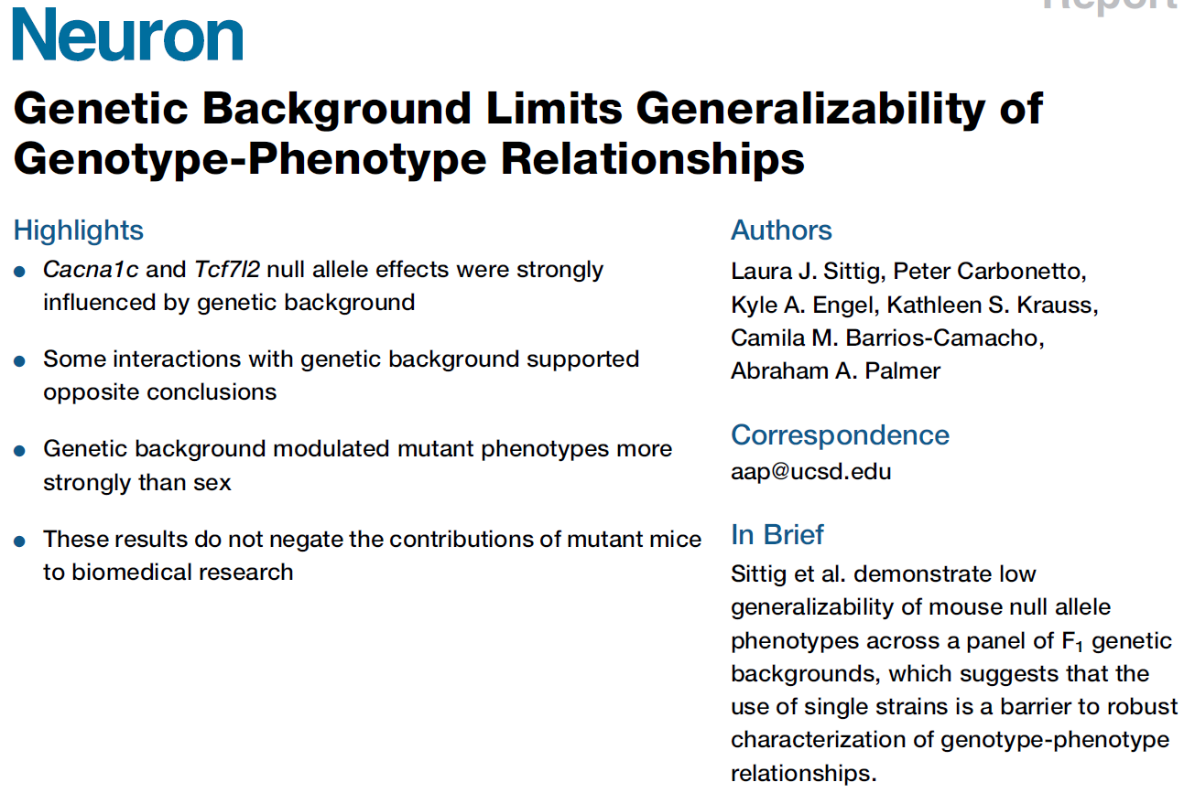
Genetic background affects phenotype values
Notes:
Do males or females have higher RBC?
Does C57BL/6J show a sex difference in RBC?

Slide 11
Genetic background affects phenotype values
Notes:
Do males or females have higher RBC?
Does C57BL/6J show a sex difference in RBC?

Slide 12
Genetic background affects phenotype values
Notes:
Figure 2. Null Allele Phenotypes on 30 Different Genetic Backgrounds
(A) Locomotor response to methamphetamine in Cacna1c+/ and Cacna1c+/+ mice. On days 1 and 2, a saline injection was given before a 30min exposure to an
open field. On day 3, methamphetamine (2 mg/kg i.p. [intraperitoneally]) was given before the open field. The difference in locomotor activity on day 3 compared
to activity on day 2 is shown.
(B) Exploratory activity during a 30 min open field test in Tcf7l2+/ and Tcf7l2+/+ mice.
(C) Baseline blood glucose levels in Tcf7l2+/ and Tcf7l2+/+ mice.
(D) Startle response to a 120-dB acoustic stimulus in Tcf7l2+/ and Tcf7l2+/+ mice.
Bars show the mean phenotype ± SEM. F1s are labeled according to the maternal strain and are ordered along the x axis according to the difference
between +/ and +/+ mice. See also Table S3. Null allele effects within strains were evaluated using two-tailed t tests. p < 0.1, *p < 0.05, **p < 0.01,
***p < 0.001.

Slide 13
Sometimes, reduced genetic diversity is a good thing
What if two closely related strains have a large different in phenotype values (i.e. cholesterol)?
If the two strains differ at a few thousand SNPs, there are not many candidate polymorphisms (and hence candidate genes).

Slide 14
C57BL/6J: Established in 1921
C57BL/6N: Established in 1951 from C57BL/6J
Differ by 18,863 SNPs, 23,520 short indels & 292 larger structural variants.
Only 269 missense SNPs.

Slide 15
Kumar et al., Science, 2013
Notes:
Acute and sensitized cocaine response, measured by locomotor hyperactivity, is lower in C57BL/6N (B6N) substrain than in C57BL/6J (B6J). (A) Baseline locomotor velocity data of B6J (blue) and B6N (green) mice were measured for 30 minutes and then injected with cocaine (20 mg/kg, red arrow) and recorded for further 60 minutes. (B) Cocaine dose response for B6J and B6N. (C) Decreased methamphetamine response in B6N. Animals were injected with methamphetamine (2mg/kg, red arrow) and recorded for 3 hours. (D) Methamphetamine dose response for B6J and B6N. Mice were treated with 1mg/kg, 2mg/kg and 4mg/kg of the drug. Average response 60 minutes post injection is shown. (E, F) B6N have a lower sensitized response to cocaine at 10mg/kg (E) but respond similarly at 15mg/kg dose (F). Mice were measured for baseline and post injection response for one hour and injected with saline(S) or cocaine(C). 30-minute post injection response is shown. All data are shown as mean ± SEM, the number of animals in each group is indicated; *p<0.05,**p<0.01,***p<0.001,****p<0.0001 from Tukey post hoc test following two way ANOVA (B,D) or pair wise t-test (E,F).

Slide 16
Another example: C3H substrains & tuberculosis

Slide 17
Summary
Most laboratory mice are inbred.
Laboratory mice are derived from three major subspecies.
Many classical inbred strains are closely related.
Wild-derived inbred strains contain more genetic diversity.
Reduced genetic diversity is a benefit if phenotypes differ between closely related strains.
Genetic background affects phenotypic values.

Slide 18
Outline
Laboratory mice
QTL mapping in two parent crosses
QTL mapping in eight parent crosses
Genotyping
Mapping
Diversity Outbred QTL mapping example
Benzene toxicity

Slide 19
Methods to associate genes with phenotypes
Forward Genetics: Which gene(s) influence my phenotype?
?
Gene1
?
Gene2
QTL Mapping
Mutagenesis screens
?
Phenotype
Gene3
?
i.e. blood pressure, body weight, cholesterol, ….
Gene4
?
Gene5
?
Etc….
Reverse Genetics: Which phenotype(s) are influenced by my gene?
Blood pressure
?
Cholesterol
?
Gene knockouts
Gene knockins
Gene1
Body weight
?
Grain yield
?
i.e. Dicer1, Rpa1, Bcas2, Purb, etc.
?
Coat color
Etc….
?

Slide 20
Genetic Complexity
Epistasis: Multiple genes affect one phenotype.
Gene2
Gene1
Phenotype
Gene3
i.e. blood pressure, body weight, cholesterol, ….
Gene4
Gene5
Pleiotropy: One gene affects many phenotypes.
Blood pressure
Red Blood Cells
Gene1
Body weight
i.e. Dicer1, Rpa1, Bcas2, Purb, etc.
Hemobglobin
Spleen weight

Slide 21
Quantitative Trait Locus (QTL) Mapping
QTL mapping is a method for finding genes related to a trait of interest (i.e. cholesterol).
Control environment & vary genetics.
Panel of genetically diverse mice with different cholesterol levels. (n = 200 to 300+)
Use correlation between genotypes and phenotypes of mice to find genes.

Slide 22
Single Nucleotide Polymorphisms (SNPs) act as markers along the genome
SNPs are single nucleotides in DNA that have different alleles in different mouse strains.
SNPs are used to distinguish segments of DNA.
C57BL/6J
DBA/2J
CTACTGACGACTCAGTGTACGATCGACT
CTACTGACGACGCAGTGTACGATCGACT
SNP

Slide 23
A
B
Inbred Founder Strains
X
F1 Generation
X
F2
Notes:
Which mitochondrial chromosome will the F2s have?
Which Y chromosome will the male F2s have?

Slide 24
A
B
Inbred Founder Strains
X
F1 Generation
X
SNP 1
SNP 2
F2
SNP 3
SNP 1 | AA | BB | AB | AB | BB | AA | BB | AA
SNP 2 | AB | AB | AB | AB | BB | AA | AB | AB
SNP 3 | BB | AA | AB | AB | BB | BB | AA | AB

Slide 25
Haplotype Reconstruction is performed using a Hidden Markov Model (HMM)
Markers along chromosome
SNP1 | SNP2 | SNP3 | SNP4 | SNP5 | SNP6 | SNP7 | SNP8 | SNP9 | SNP10 | SNP11 | SNP12 | SNP13
A | A | T | G | C | C | T | G | A | G | G | C | A
C | G | G | A | T | T | A | A | G | T | T | G | C
A | A | T | G | T | T | A | A | G | T | G | C | A
A | A | G | A | T | T | T | G | A | G | G | C | A
C57BL/6J
DBA/2J
BxD F2 #1
BxD F2 #2

Slide 26
Cholesterol
Variation
Mouse

Slide 27
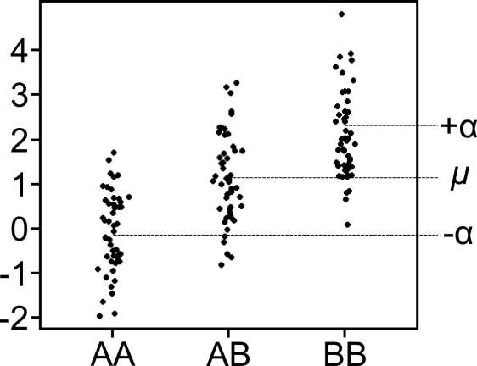
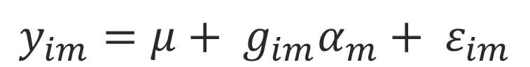
Quantitative Trait Locus (QTL) Mapping
Phenotype mean
Genotype of animal i at marker m
Allele effect of marker m
Phenotype of animal i at marker m
$$y_{im}=μ+ g_{im}α_{m}+ ε_{im}$$
Residual error for animal i

Slide 28
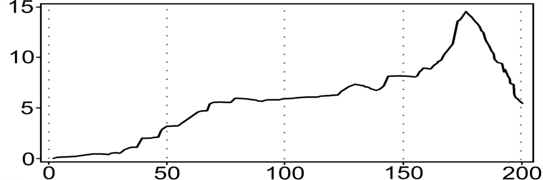
Cholesterol
AA
AB
BB
AA
AB
BB
AA
AB
BB
LOD
Chr 1 (Mb)

Slide 29
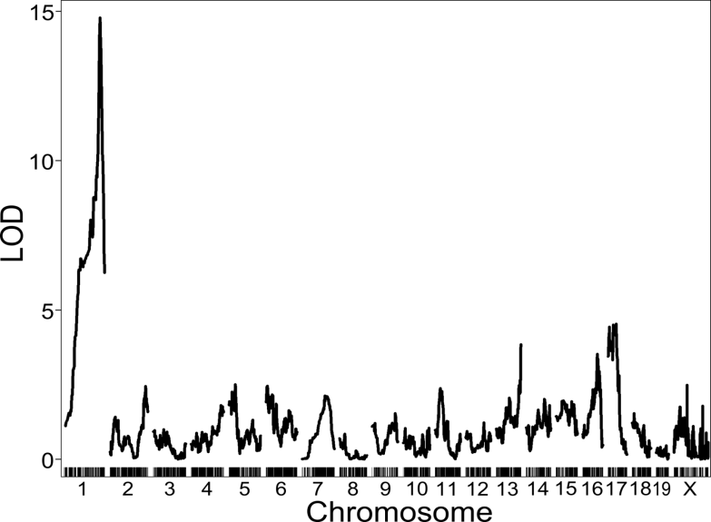
Genome Scan for Cholesterol

Slide 30
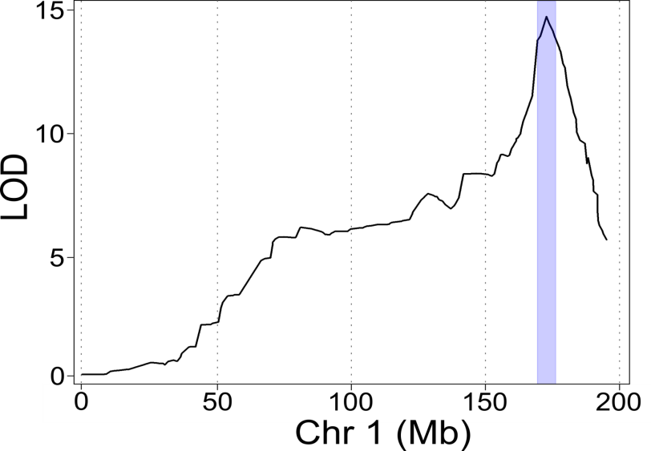
Support Interval around QTL Peak
171 – 178 Mb

Slide 31
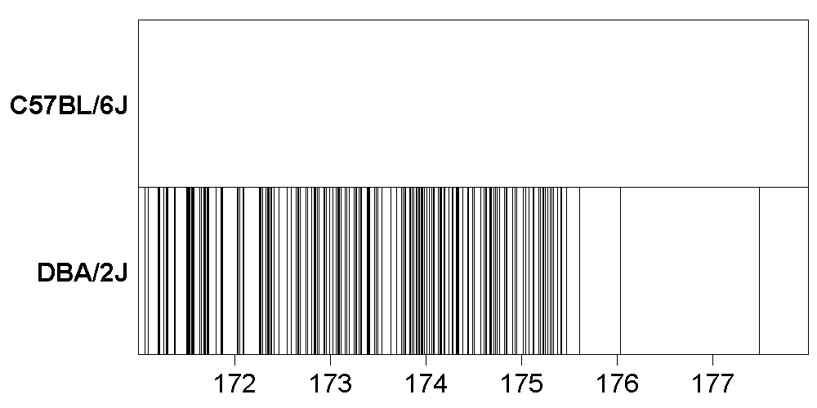
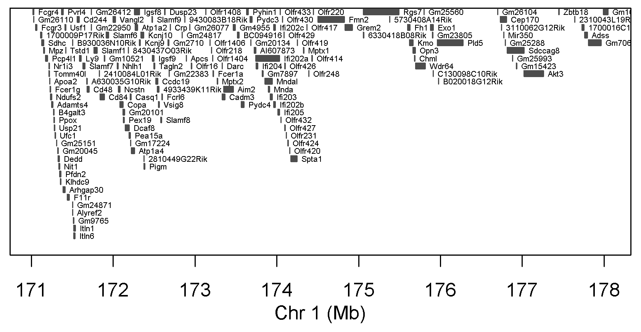
A
B
44,315
SNPs
153 Genes

Slide 32
Pros and Cons of F2 population
Pro | Con
Easy to create | Low genetic diversity (only 2 parental strains) masks much of the genome
High statistical power | Wide confidence intervals with many genes
High minor allele frequency (50%)

Slide 33
How would you increase mapping resolution?
Trait
More mice.
7
8
2
1
3
7
8
7
9
2
1

Slide 34
How would you increase mapping resolution?
More crossing → more recombinations.
Broman,K.W., Genetics 2005
Broman, K.W., Genes, Genomes, Genetics, 2012

Slide 35
How would you increase mapping resolution?
Trait
More crossing → more recombinations.
7
8
9
8
7
7
1
2
2
3
1

Slide 36
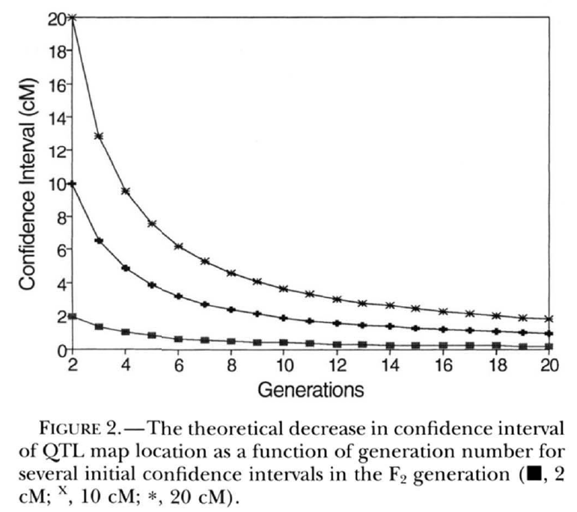
Advanced Intercross Lines
Produced from multiple founders.
Crossed for more than two generations.
Increases mapping resolution, i.e. smaller confidence intervals with fewer genes.
Genetics. 1995 Nov;141(3):1199-207.
Advanced intercross lines, an experimental population for fine genetic mapping.
Darvasi A¹, Soller M.
http://www.ncbi.nlm.nih.gov/pubmed/8582624

Slide 37
Advanced Intercross Lines
Previously, genotyping was more expensive than phenotyping.
Also, the recombination density in an F2 did not require dense genotyping.
Today, we can genotype 100,000+ markers for $100.
So, it makes sense to increase recombination density.
Power may be reduced because large effect QTL in an F2 may resolve to many small effect QTL in later generations.

Slide 38
Summary
F2 populations are crosses between two inbred lines.
F2 mice are outbred mice. Each is genetically unique and must be genotyped.
The F2 generation provides one opportunity for recombination and mapping resolution is coarse.
Power is high because each marker contains an even number of alleles from each parent.
Mapping resolution can be made finer by increasing the number of mice and/or the number of generations of outcrossing (AILs).

Slide 39
Outline
Laboratory mice
QTL mapping in two parent crosses
QTL mapping in multi-parent crosses
Genotyping
Mapping
Diversity Outbred QTL mapping example
Benzene toxicity

Slide 40
Much of the human genome can be mapped onto the mouse genome
Ali et al., BMC Bioinf., 2013

Slide 41
What if we could engineer a SNP in every gene?
Ali et al., BMC Bioinf., 2013

Slide 42

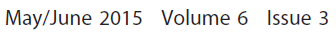
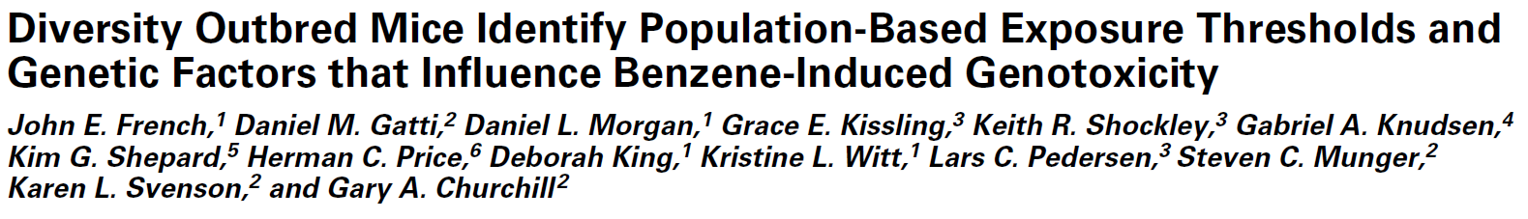
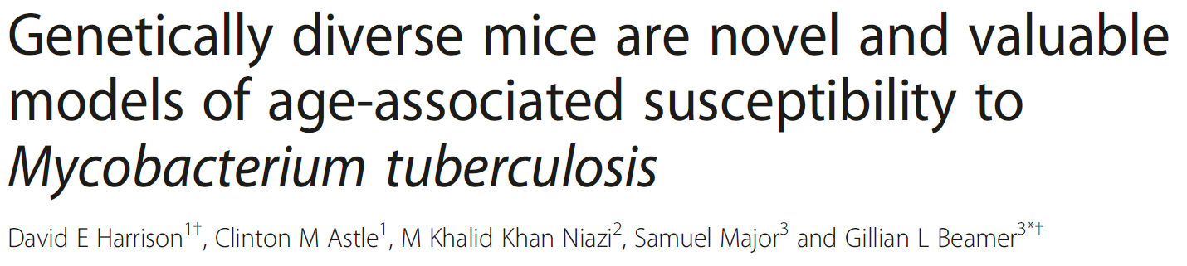
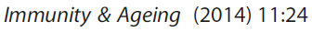
Genetically diverse mouse models may improve translational relevance

Slide 43
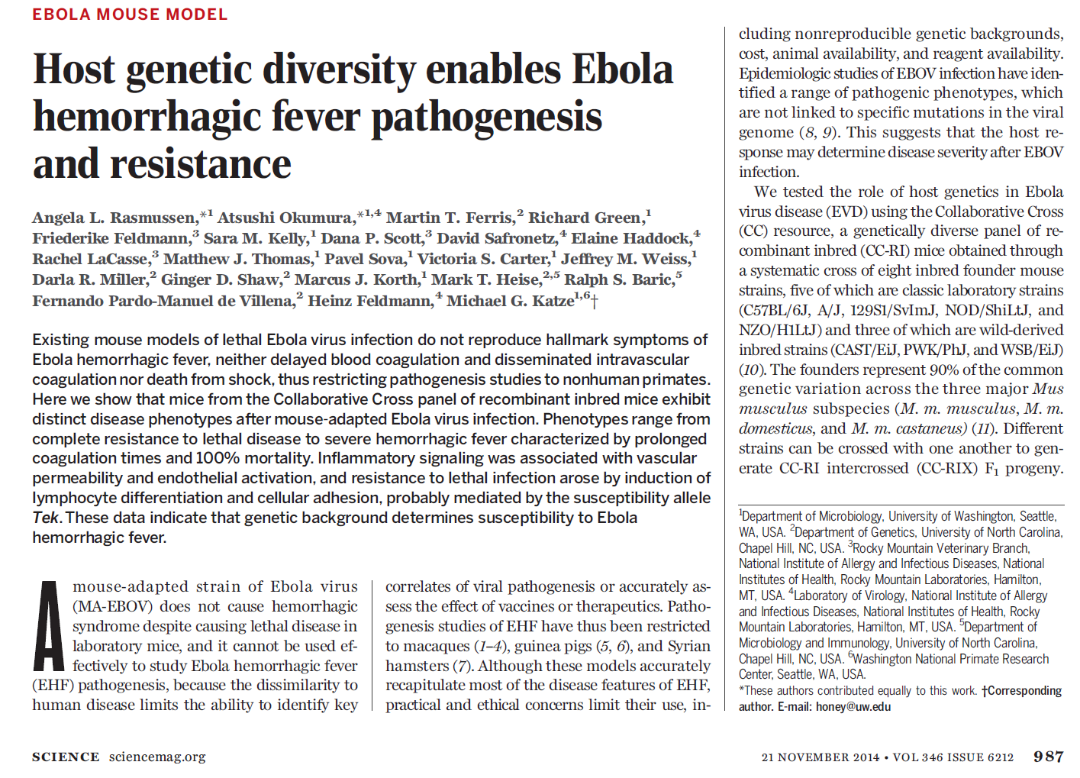
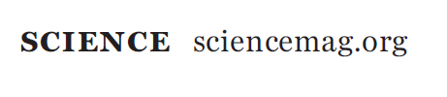

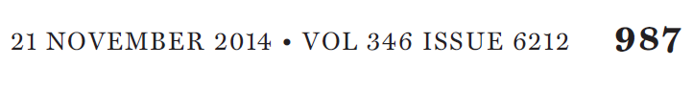

Slide 44
Reviews on QTL Mapping
Dissecting quantitative traits in mice.
Annu Rev Genomics Hum Genet. 2013;14:421-39
Mott R, Flint J.
http://www.ncbi.nlm.nih.gov/pubmed/23834320
Genome-wide association studies in mice.
Nat Rev Genet. 2012 Nov;13(11):807-17.
Flint J, Eskin E.
http://www.ncbi.nlm.nih.gov/pubmed/23044826
Fine-mapping QTLs in advanced intercross lines and other outbred populations.
Mamm Genome. 2014 Aug;25(7-8):271-92
Gonzales NM, Palmer AA.
http://www.ncbi.nlm.nih.gov/pubmed/24906874

Slide 45
Multi-parent Advanced Generation Intercrosses (MAGIC)
Increase genetic diversity.
Use two distantly related founder strains.
Use more than two founder strains.
Increase the number of recombinations (and hence, mapping resolution).
Cross lines for more generations.

Slide 46
Organisms with MAGIC lines
Arabadopsis: http://journals.plos.org/plosgenetics/article?id=10.1371/journal.pgen.1000551
Wheat: http://www.g3journal.org/content/4/9/1603.full
Maize: http://www.genetics.org/content/198/4/1717.full
Fruit Fly: http://wfitch.bio.uci.edu/~dspr/
Rat: http://www.nature.com/ng/journal/v45/n7/full/ng.2644.html
Mouse: http://csbio.unc.edu/CCstatus/index.py
http://mus.well.ox.ac.uk/CC/
http://do.jax.org
Others….

Slide 47
Founder Strains: Color/Letter Codes
Millions of SNPs
4.2
0
4.4
4.3
4.5
17.7
17.2
6.0
A/J
C57BL/6J
129S1/SvImJ
NOD/ShiLtJ
NZO/HlLtJ
CAST/EiJ
PWK/PhJ
WSB/EiJ
A
B
C
D
E
F
G
H
Classical Inbred
Wild Derived Inbred
Keane, TM, Nature, 2011

Slide 48
Founder Strains
All eight founders have been fully sequenced.
SNPs, short indels and larger structural variants are known.
Unlike human association mapping, we have the causal variants for many phenotypes.

Slide 49
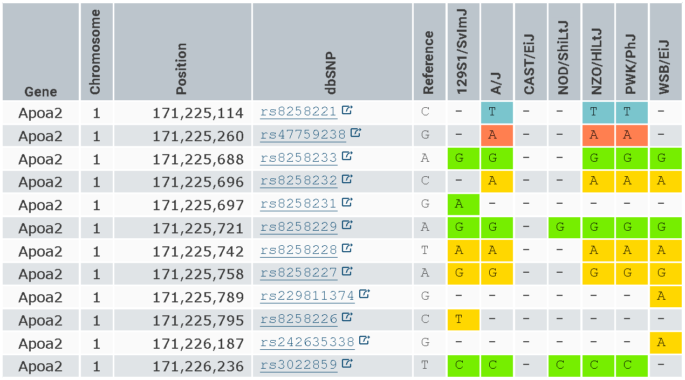
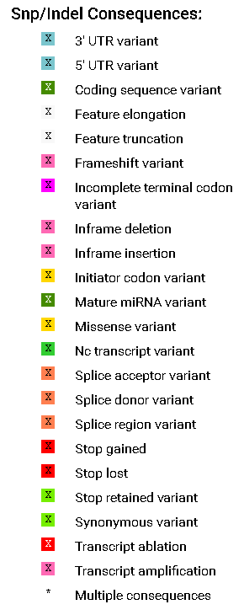
Founder Strain Sequences are available from the Sanger Mouse Genomes Project
http://www.sanger.ac.uk/resources/mouse/genomes/

Slide 50
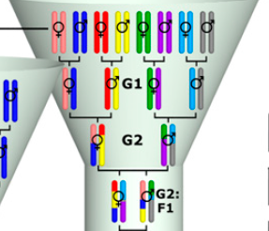
Mouse Collaborative Cross
M
Y
M
Y
M
Y
M
Y
Collaborative Cross Consortium, Genetics; 2012
Notes:
Why would you want to vary the founder order at the top of the funnel?
What is different about each CC line?
Which founder contributes the M chromosome?
Which founder contributes the Y chromosome?

Slide 51
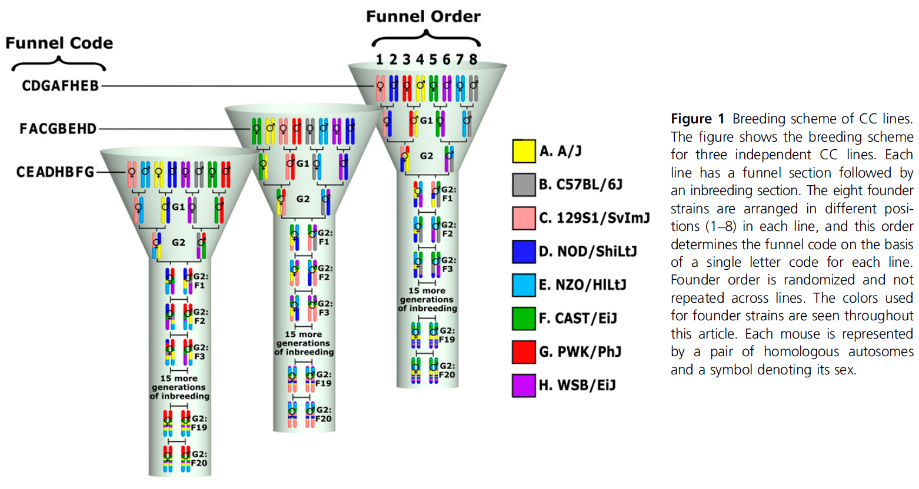
Mouse Collaborative Cross
Collaborative Cross Consortium, Genetics; 2012

Slide 52
Mouse Collaborative Cross
Each line is (mostly) inbred.
Roughly 200 recombinations per line.
Useful to compare control and treated groups.
Useful when multiple replicates of the same genotype are needed (noisy traits).
http://csbio.unc.edu/CCstatus/index.py

Slide 53
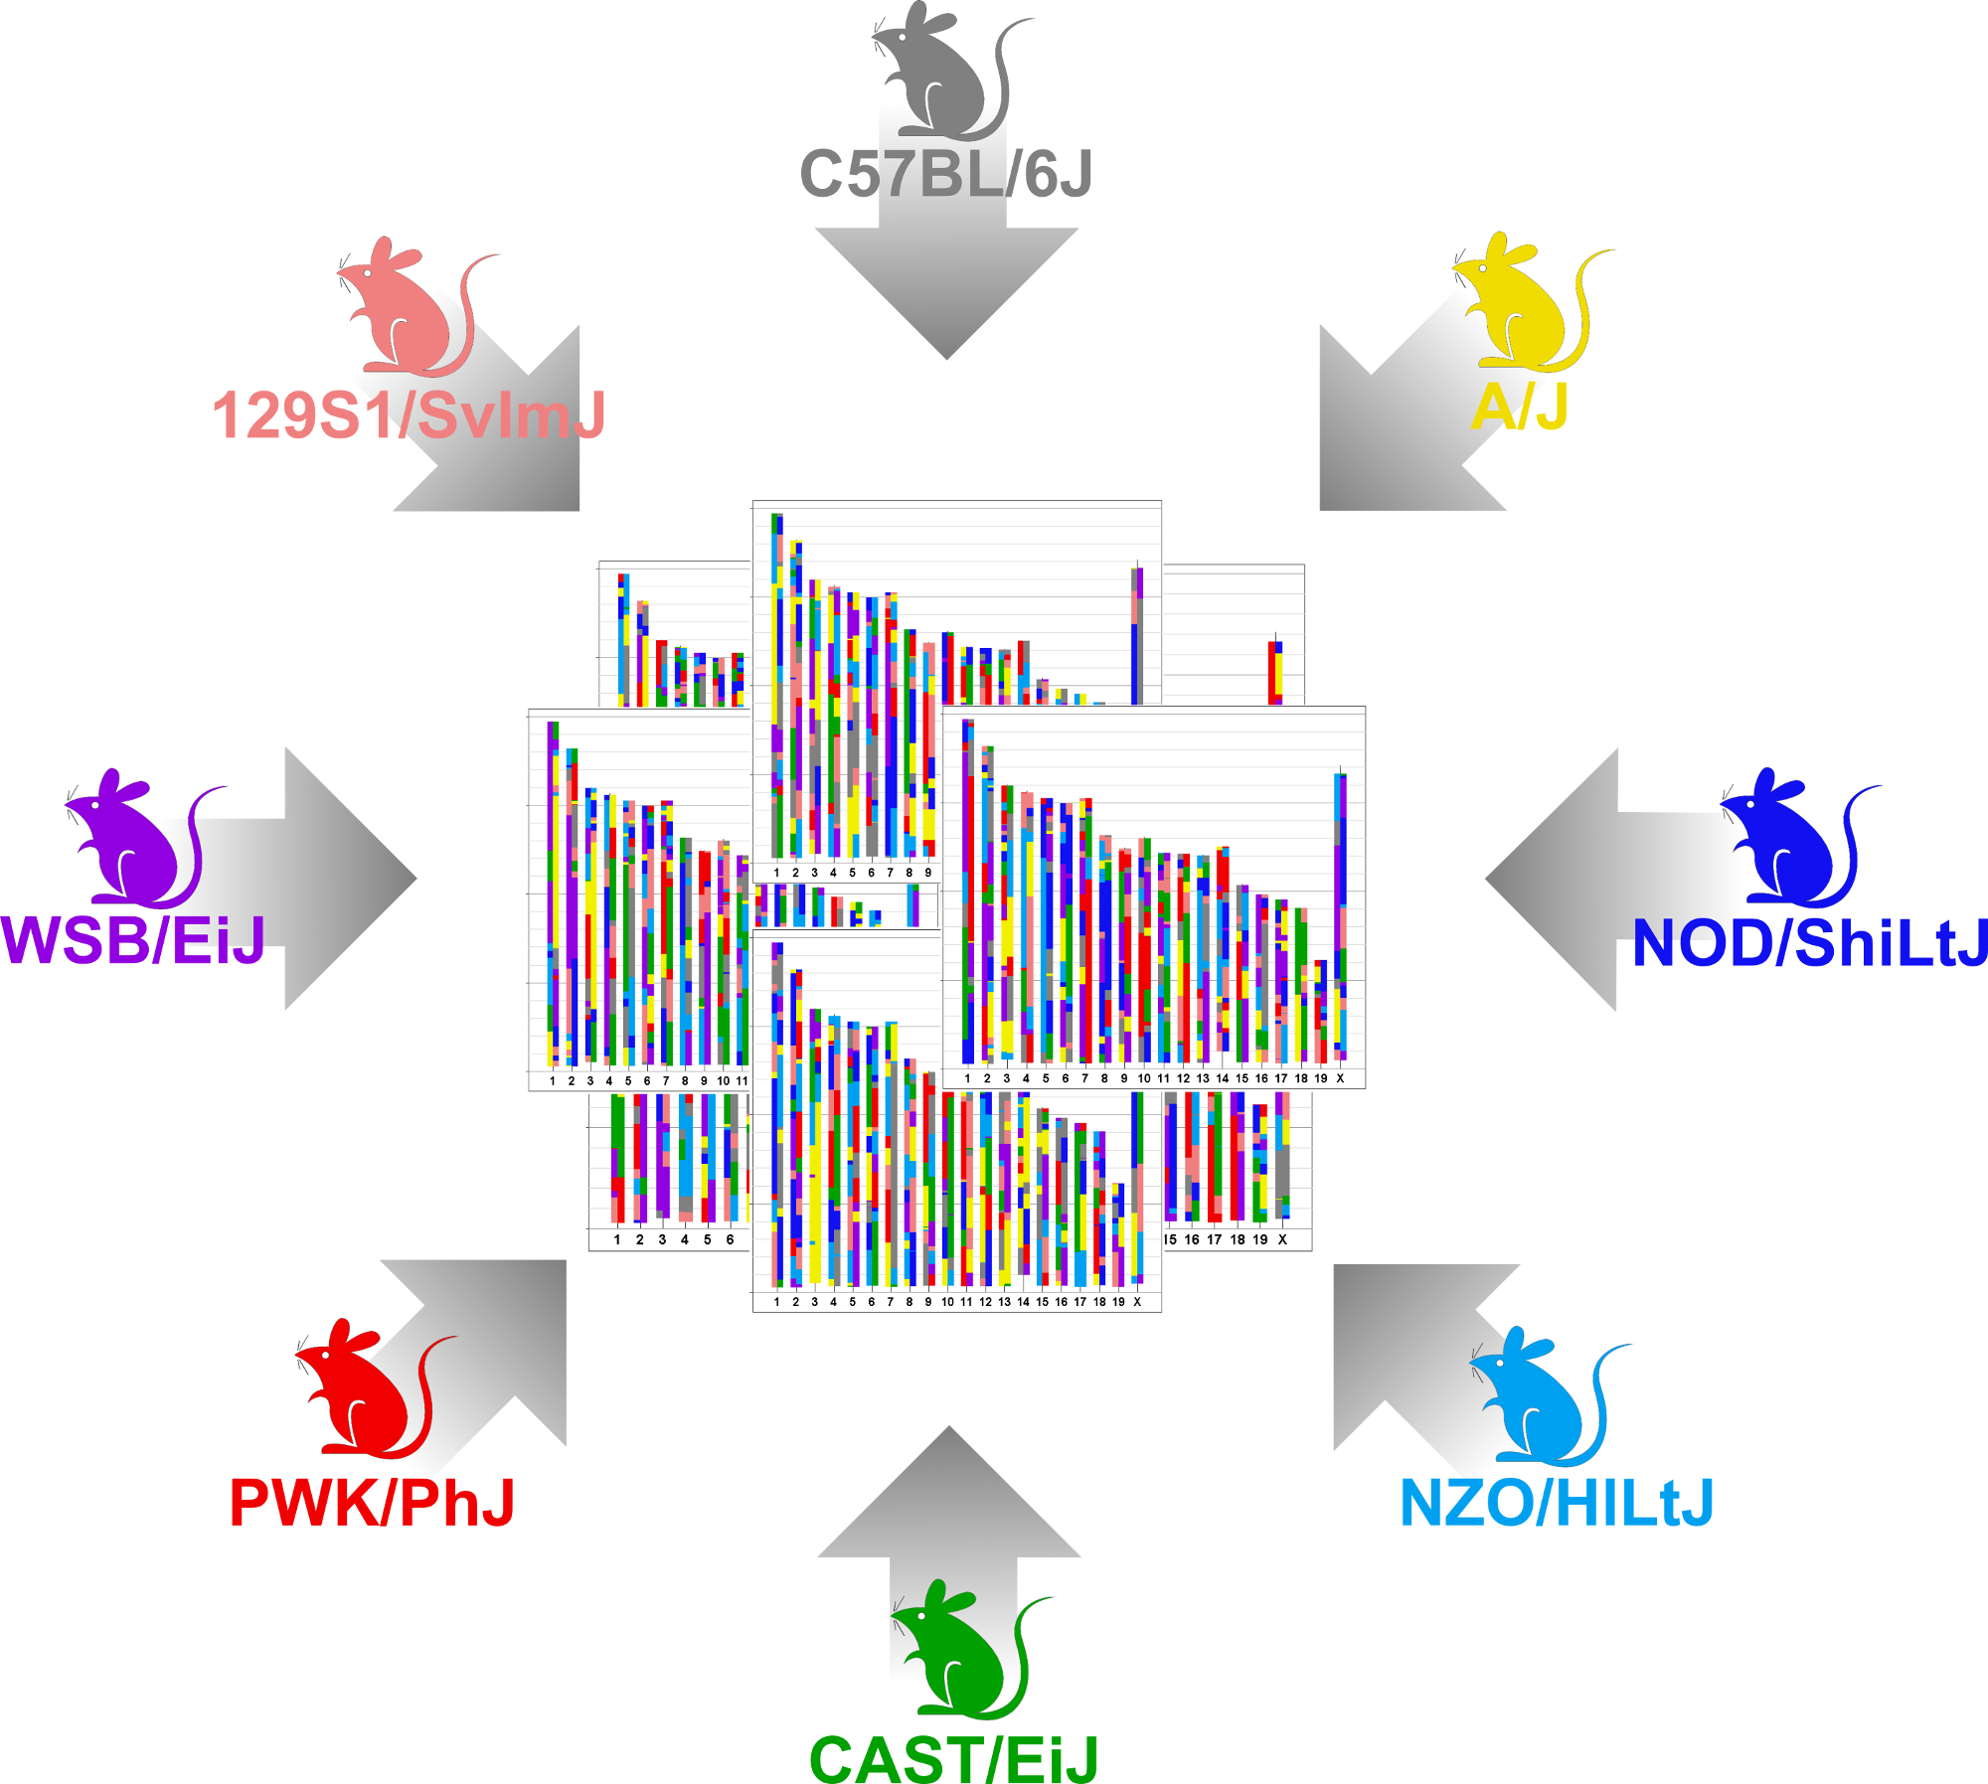
Diversity Outbred Mice
Same 8 founders as Collaborative Cross.
Maintained as an outbred population via random mating.
http://jaxmice.jax.org/strain/009376.html
http://do.jax.org

Slide 54
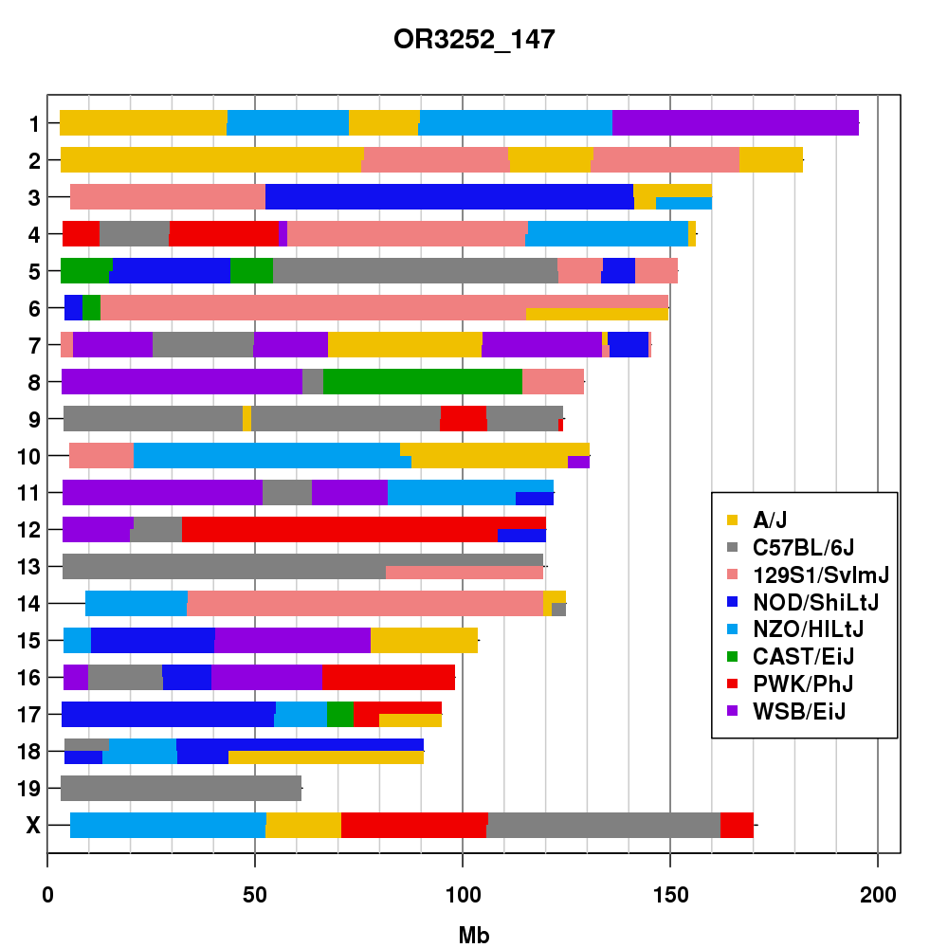
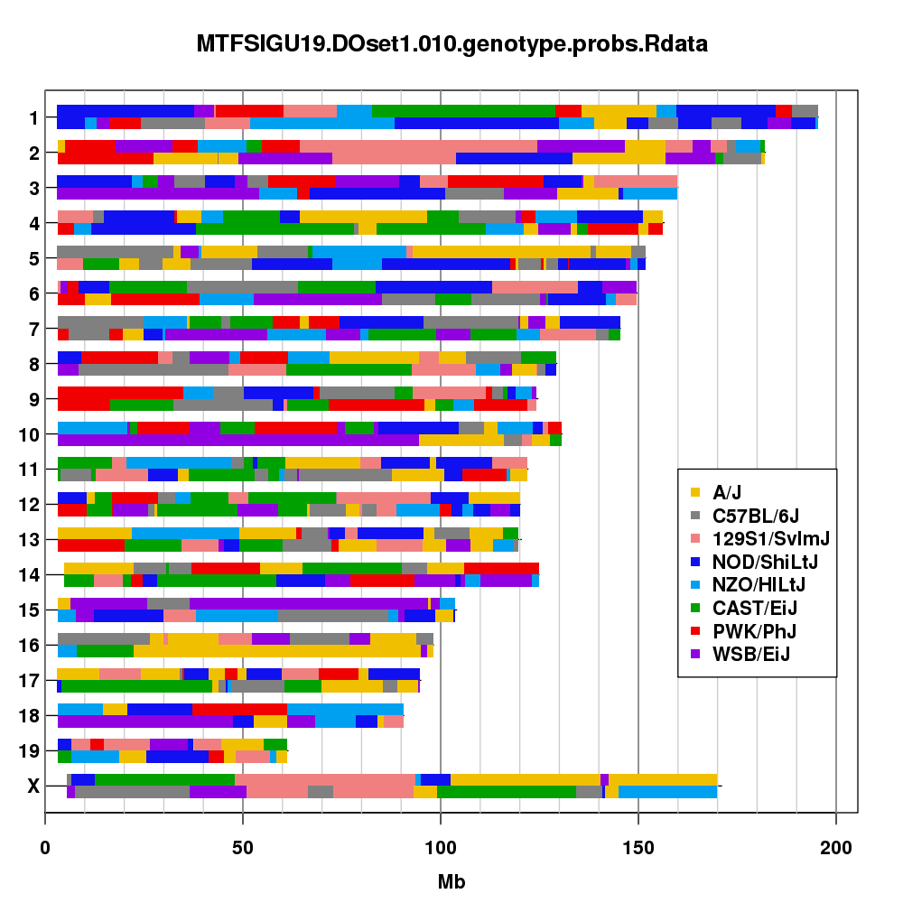
CC and DO Genome Comparison
Collaborative Cross Line
Diversity Outbred Mouse

Slide 55
CC and DO Comparison
Collaborative Cross
Multiple replicates of same genotype.
Genotype each line (reduced cost).
Fewer recombinations per line (~200 per line).
Higher power.
Diversity Outbred
Each mouse is genetically unique.
Genotype each mouse.
Increasing recombinations with each generation (~500 at G19).
Finer mapping resolution.

Slide 56
Correlation between phenotypes
You are looking for biomarkers of a drug-induced toxicity
You can afford to phenotype 200 mice.
Do you:
Phenotype 10 mice from each of 20 inbred strains?
Phenotype 200 outbred mice?

Slide 57
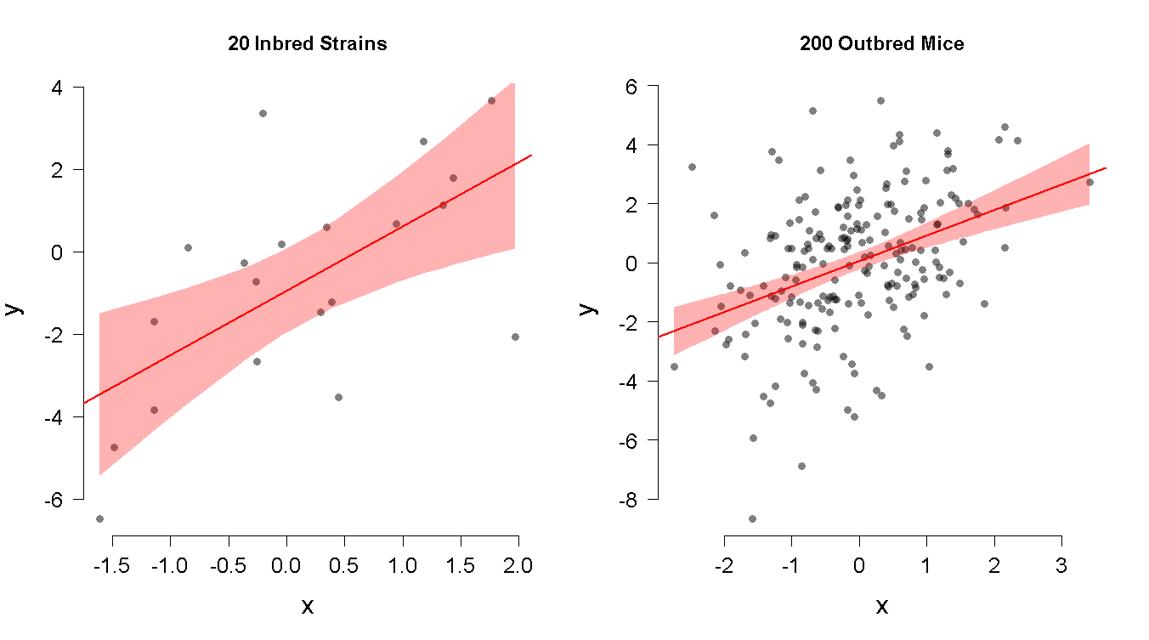
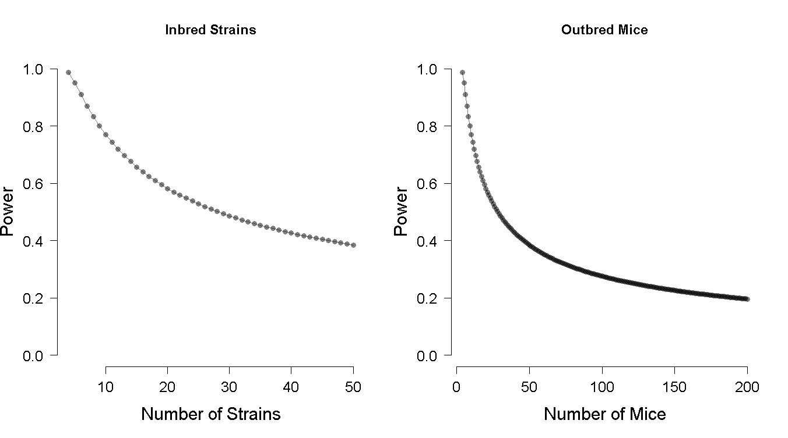
Correlation between phenotypes

Slide 58
Summary
Increased genetic diversity increases the number of genes with differential expression or altered protein structure.
There are two major mouse crosses derived from the same 8 founder strains:
Collaborative Cross: inbred strains.
Useful when replicate measurements are needed.
Mapping power is higher, but mapping resolution is lower.
Diversity Outbred: outbred population.
Useful for high resolution genetic mapping and correlations between phenotypes.
Mapping power is lower, but mapping resolution is higher.

Slide 59
Outline
The Jackson Laboratory
Inbred mice
QTL mapping in two parent crosses
QTL mapping in eight parent crosses
Genotyping
Mapping
Diversity Outbred QTL mapping example
Benzene toxicity

Slide 60
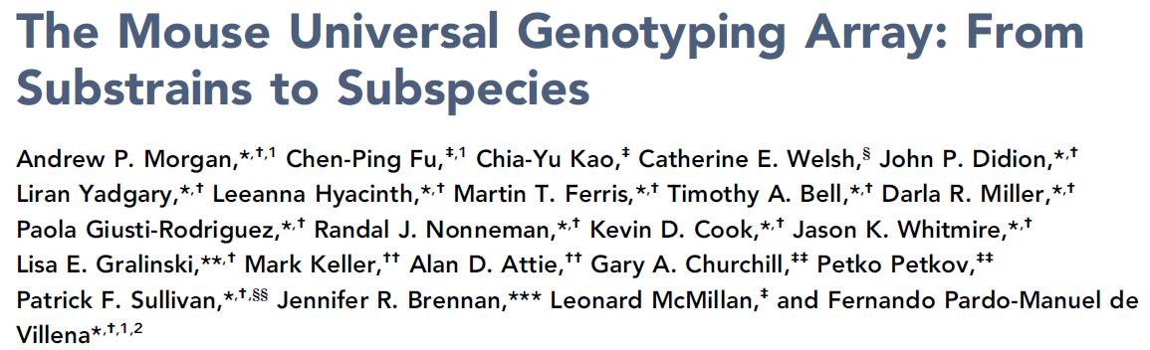
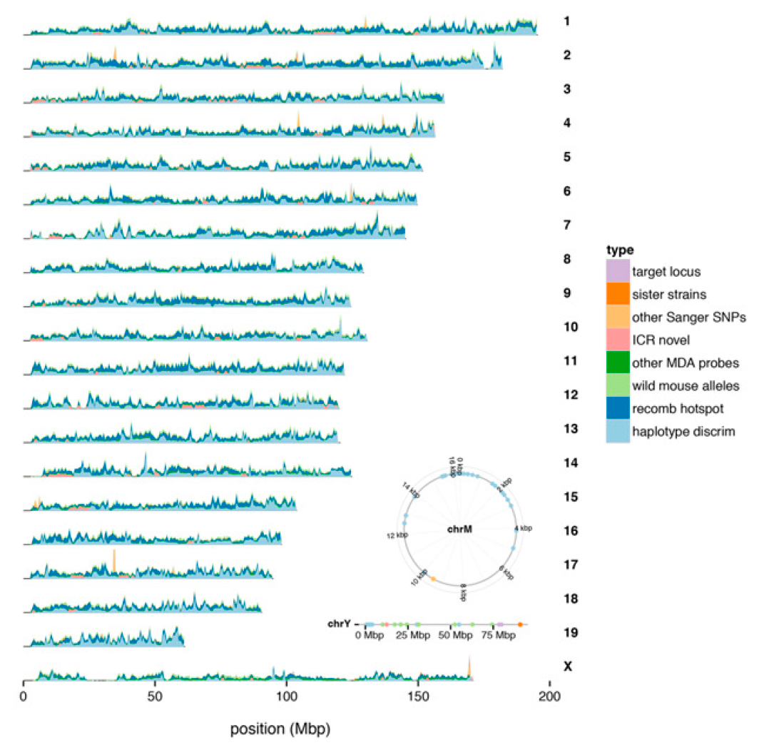
Mice are genotyped on a high density SNP microarray
GigaMUGA
141,090 SNPs
$100 per sample
http://www.g3journal.org/content/6/2/263

Slide 61
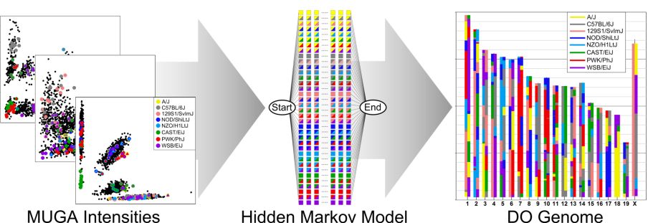
HMM to Reconstruct Genomes

Slide 62
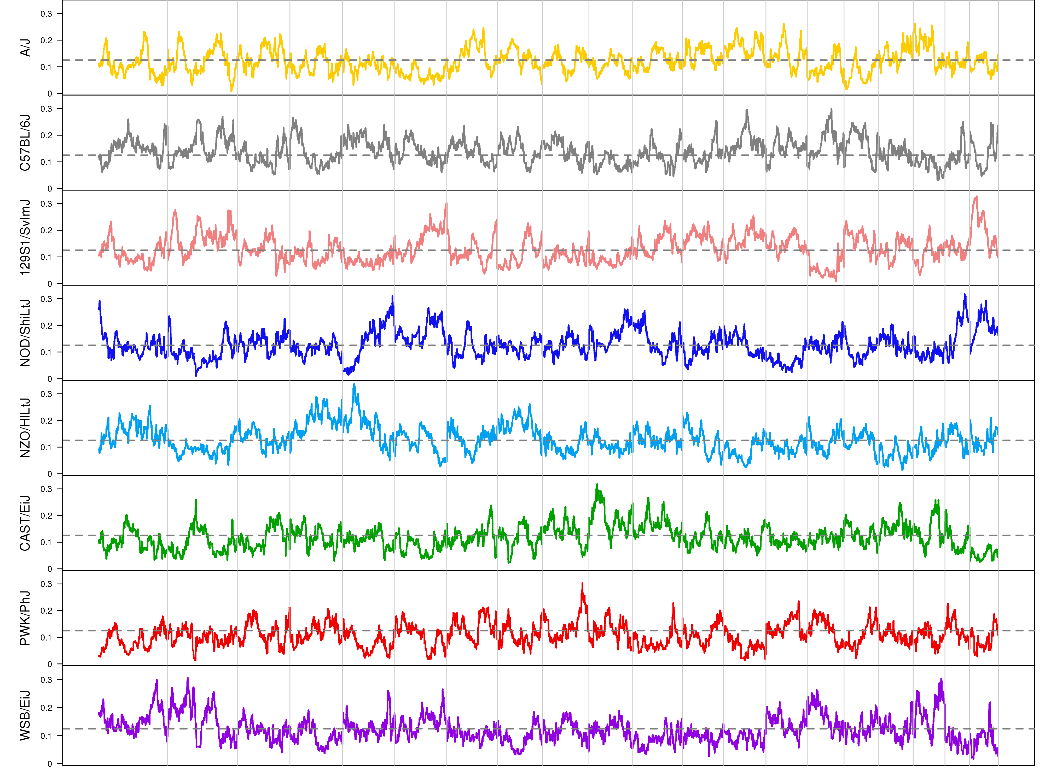
DO Mice have Balanced Founder Allele Proportions across the Genome
A/J
C57BL/6J
129S1/SvImJ
NOD/ShiLtJ
NZO/HlLtJ
CAST/EiJ
PWK/PhJ
WSB/EiJ

Slide 63
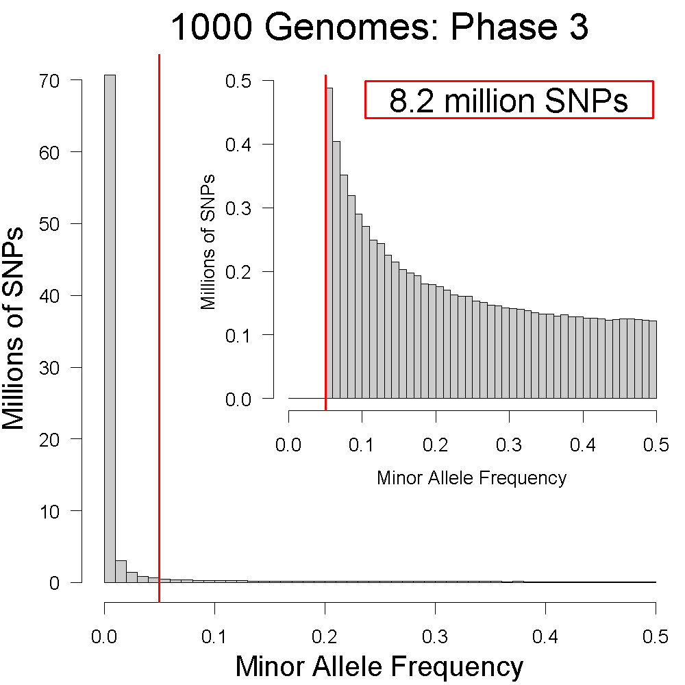
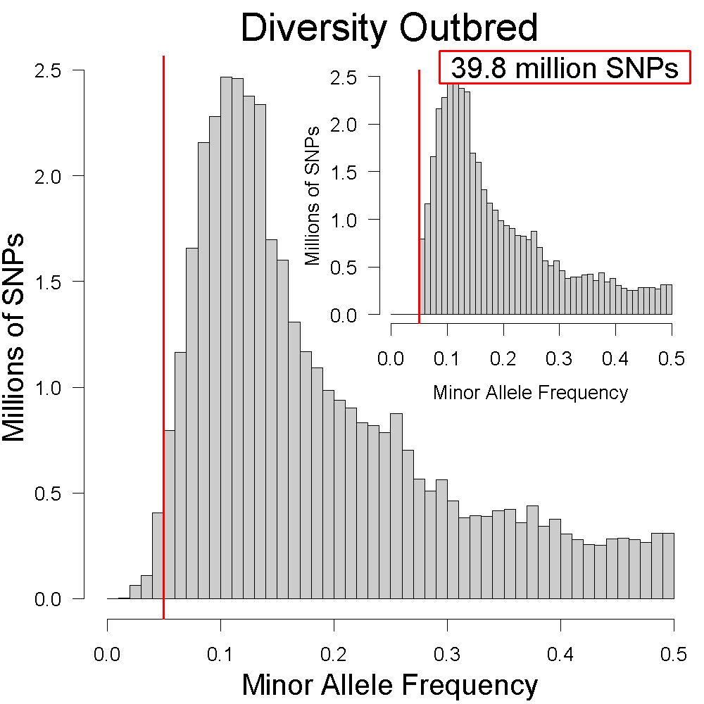
DO Mice have more SNPs with MAF > 5%
1000 Genomes
2,504 samples
84,801,880 SNPs
Diversity Outbred
2,936 samples
40,425,646 SNPs

Slide 64
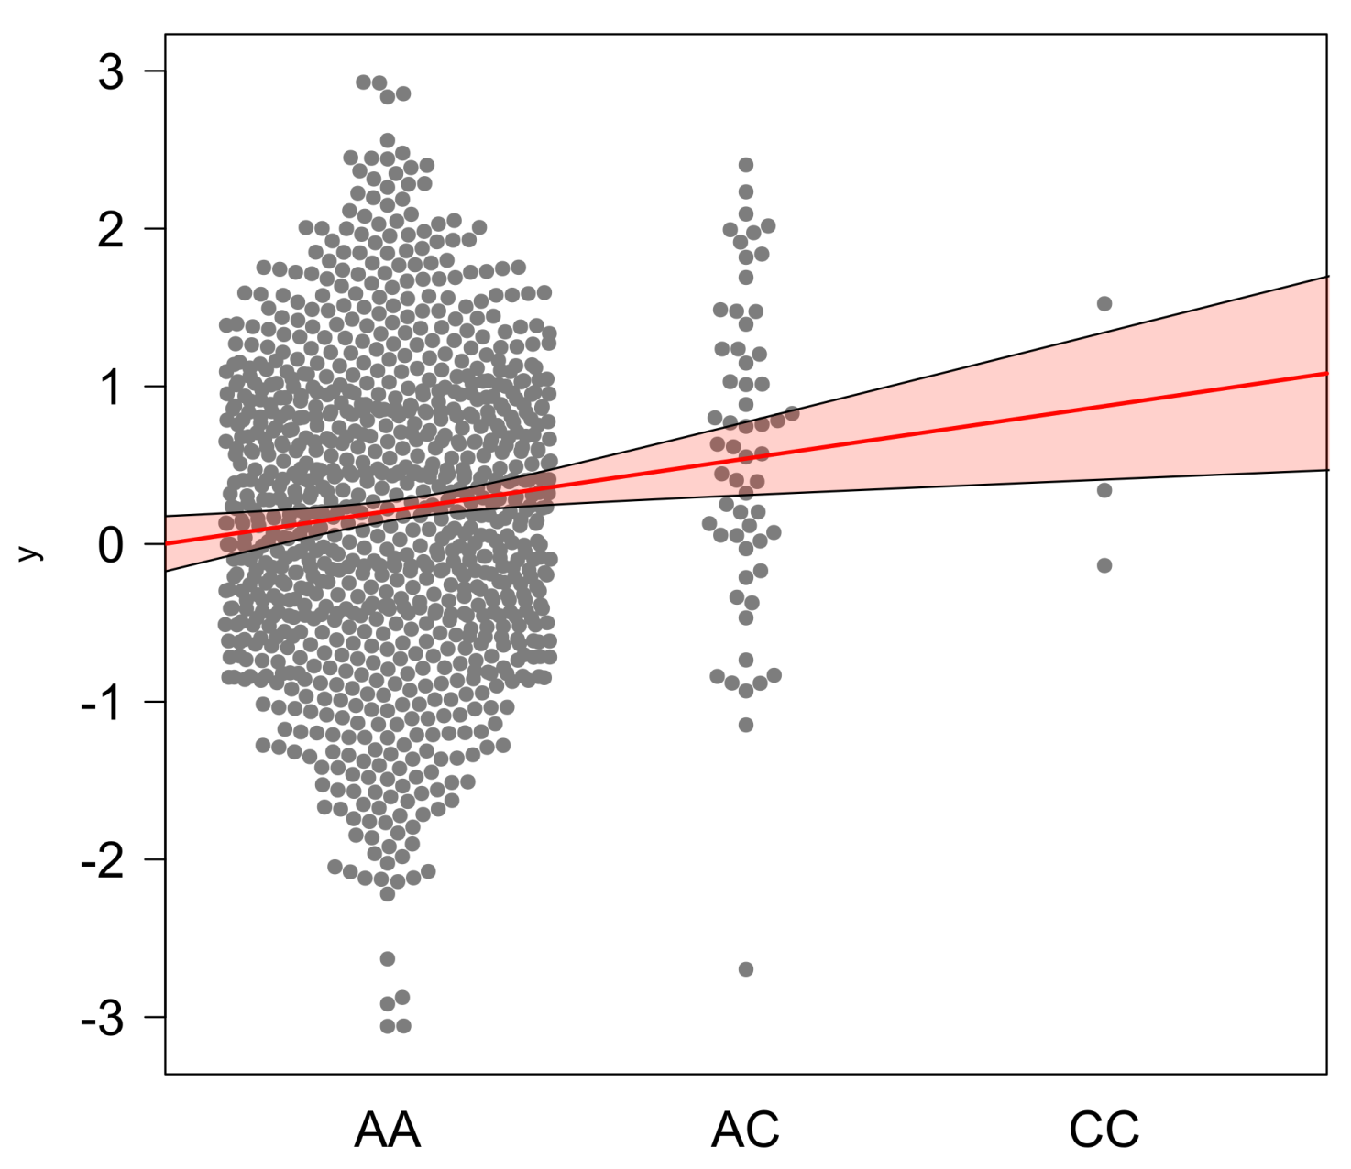
Low minor allele frequency decreases power
n = 1000
MAF = 5%

Slide 65
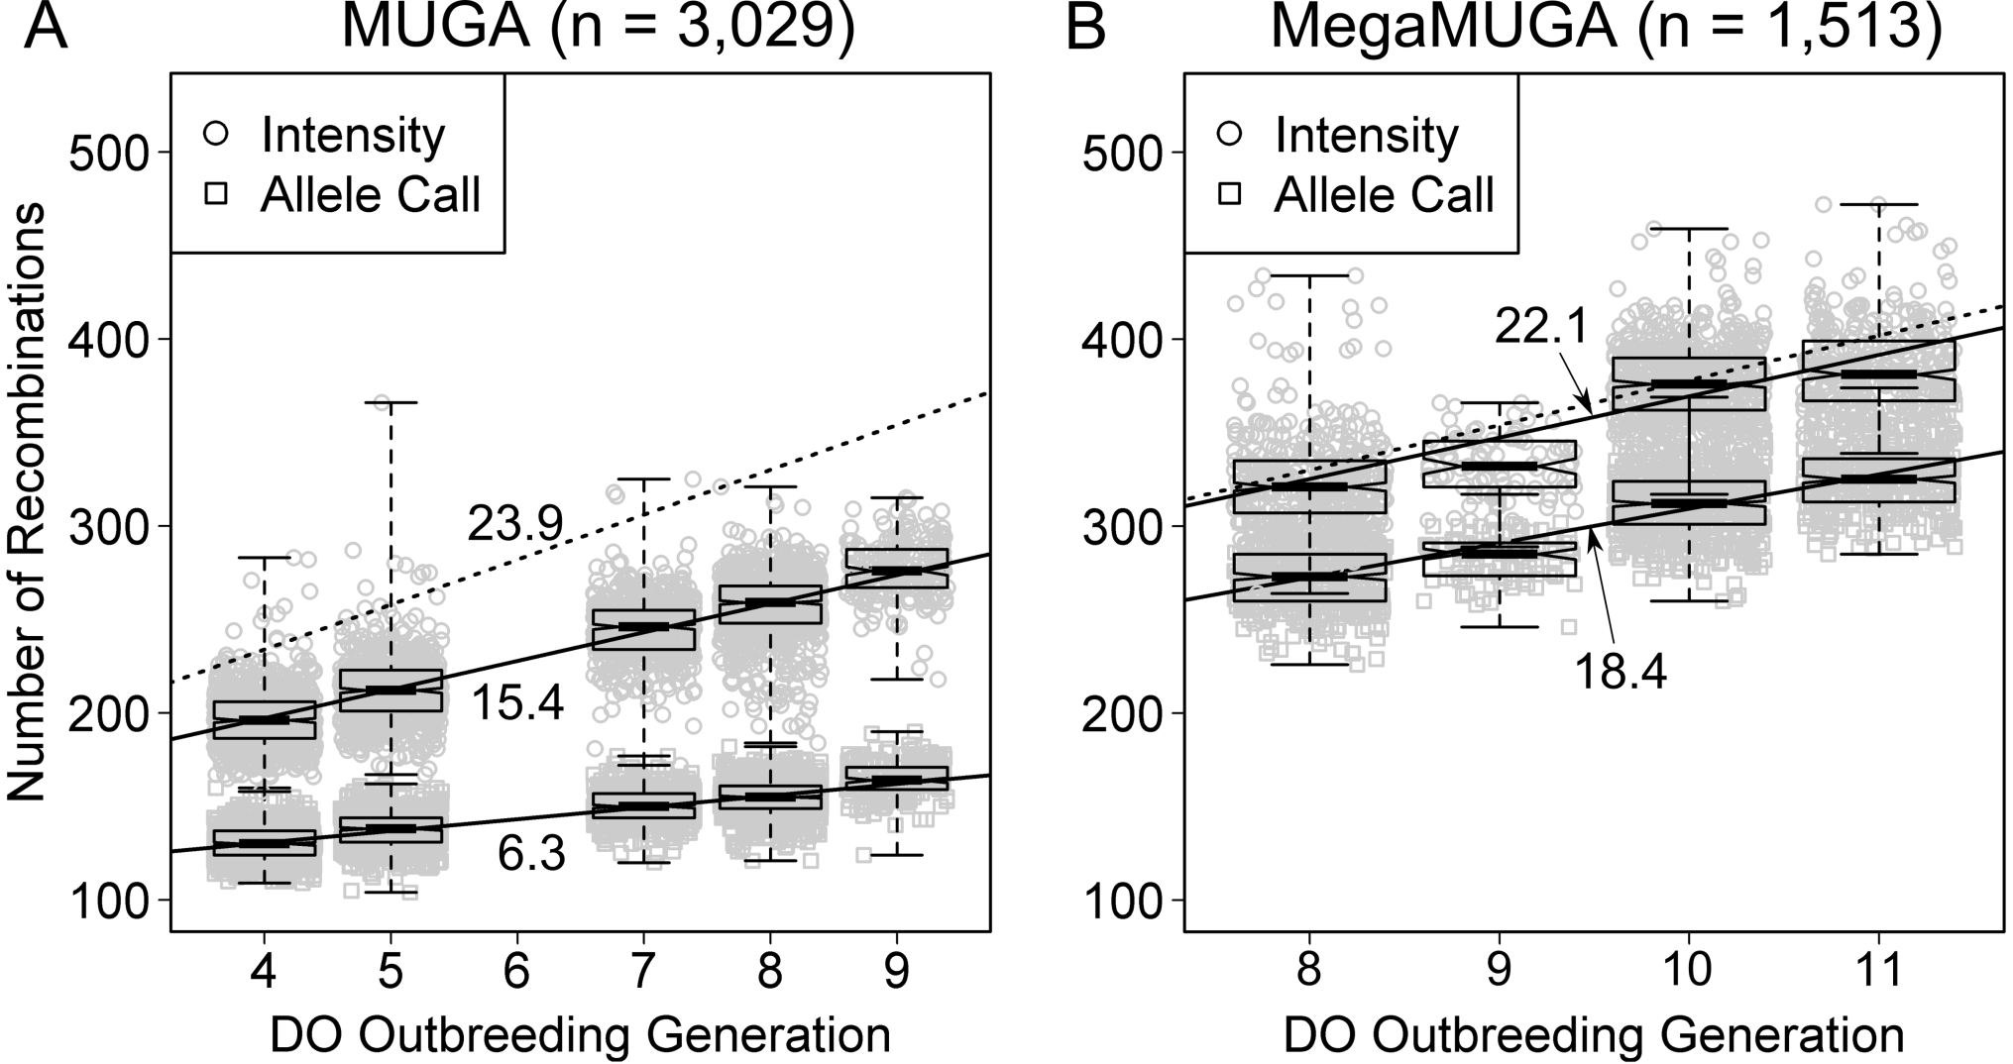
Number of Recombinations per Mouse

Slide 66
Outline
The Jackson Laboratory
Laboratory mice
QTL mapping in two parent crosses
QTL mapping in eight parent crosses
Genotyping
Mapping
Diversity Outbred QTL mapping example
Benzene toxicity

Slide 67
We condense the 36 genotype probabilities to 8 founder haplotype probabilities
For each sample, we have 36 genotype probabilities at each SNP.
We condense these down to 8 state founder probabilities.
AA | AB | AC | AD | AE | AF | AG | AH | BB | BC | BD | BE | BF | BG | BH | CC | CD | CE | CF | CG | CH | DD | DE | DF | DG | DH | EE | EF | EG | EH | FF | FG | FH | GG | GH | HH
0 | 0 | 0 | 0 | 0 | 0 | 0 | 0 | 1 | 0 | 0 | 0 | 0 | 0 | 0 | 0 | 0 | 0 | 0 | 0 | 0 | 0 | 0 | 0 | 0 | 0 | 0 | 0 | 0 | 0 | 0 | 0 | 0 | 0 | 0 | 0
0 | 0 | 0 | 0 | 0 | 0 | 0 | 0 | 0 | 0 | 0 | 0 | 0 | 0 | 1 | 0 | 0 | 0 | 0 | 0 | 0 | 0 | 0 | 0 | 0 | 0 | 0 | 0 | 0 | 0 | 0 | 0 | 0 | 0 | 0 | 0
0 | 0 | 0 | 0 | 0 | 0 | 0 | 0 | 0 | 0 | 0 | 0 | 0 | 0.5 | 0.5 | 0 | 0 | 0 | 0 | 0 | 0 | 0 | 0 | 0 | 0 | 0 | 0 | 0 | 0 | 0 | 0 | 0 | 0 | 0 | 0 | 0
A | B | C | D | E | F | G | H
0 | 1 | 0 | 0 | 0 | 0 | 0 | 0
0 | 0.5 | 0 | 0 | 0 | 0 | 0 | 0.5
0 | 0.5 | 0 | 0 | 0 | 0 | 0.25 | 0.25

Slide 68
The mapping model estimates the effect of each founder allele
http://do.jax.org

Slide 69
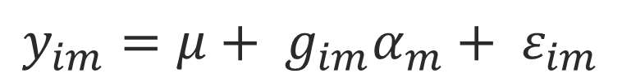
Mapping Additive Effects in F2
$$y_{im}=μ+ g_{im}α_{m}+ ε_{im}$$

Slide 70
Example: Coat Color
Coat color in ~150 DO mice recorded as:
Albino
Agouti
Black
Mapped Albino and Black separately as binary traits.
Both are homozygous recessive traits.
Albino is epistatic to black.

Slide 71
Linkage versus Association Mapping
Linkage mapping associates the phenotype with a haplotype.
Association mapping associates the phenotype with a genomic variant (like a SNP).

Slide 72
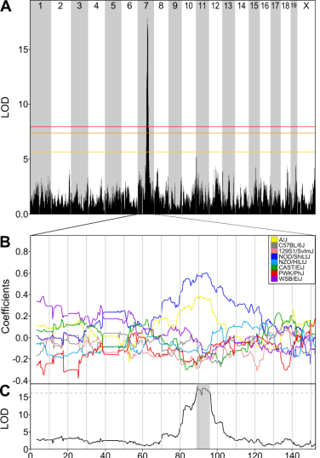
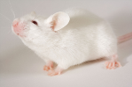
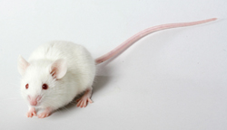
Albino
A/J
Svenson et.al. Genetics, 2011
Tyr^{c}
NOD/ShiLtJ

Slide 73
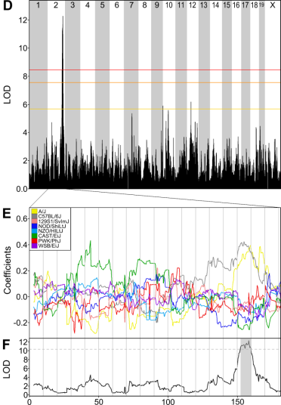
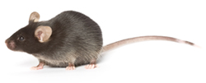
Black
A/J
Svenson et.al. Genetics, 2011
a
C57BL/6J

Slide 74
Modifier mapping using the DO
TRAMP

Slide 75
Summary
DO mice are genotyped using a microarray with ~140,000 SNPs.
The genomes of DO mice can be reconstructed in terms of the eight founder haplotypes.
The DO has balanced allele frequencies, which maximizes the number of SNPs that we can use in mapping.
We can estimate the effects of the eight founder alleles in the DO.
Modifiers of dominant genes can be mapped using DO F1s.

Slide 76
Outline
Inbred mice
QTL mapping in two parent crosses
QTL mapping in eight parent crosses
Genotyping
Mapping
Diversity Outbred QTL mapping example
Benzene toxicity

Slide 77
Benzene Inhalation Study
Day 0
7
14
21
28
0 ppm
75+75
1 ppm
75+75
10 ppm
75+75
100 ppm
75+75
6 hrs per day
5 days per week

Slide 78
Benzene Study Endpoints
Pre- and post-exposure blood
Post-exposure bone marrow
Proportion of micronucleated reticulocytes (MN-RET)
Measure of chromosomal damage
French, JE, et.al, Env. Health Persp., 2014
http://www.ncbi.nlm.nih.gov/pubmed/25376053

Slide 79
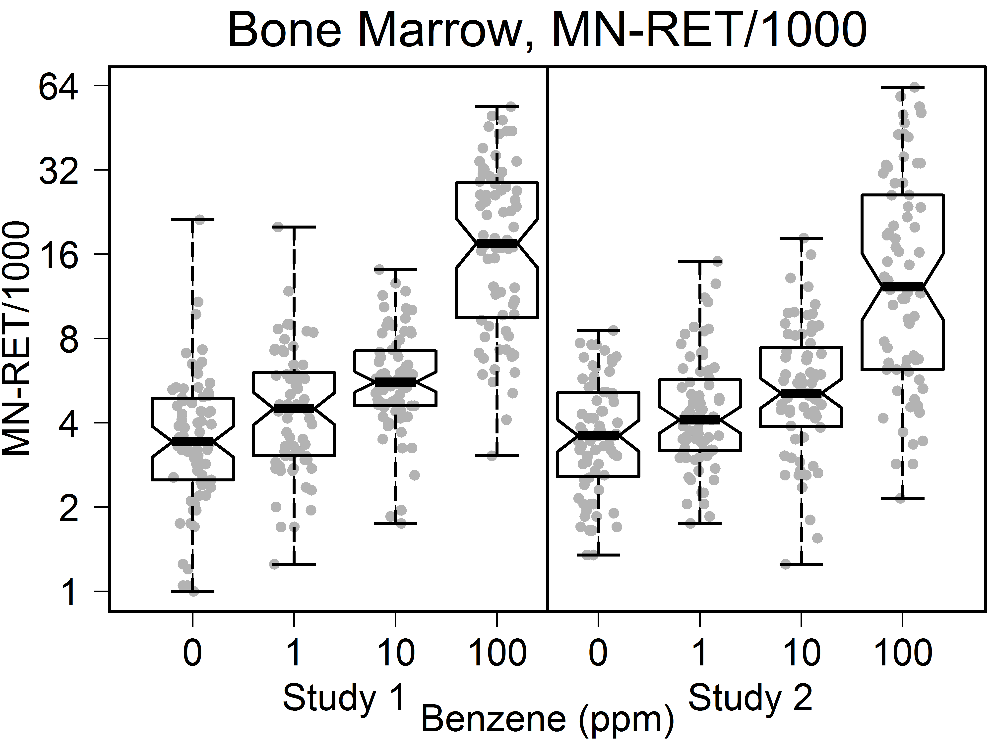
Bone Marrow MN-RET
DNA
Damage

Slide 80
Linkage Mapping Model
Map with 150 samples from 100 ppm dose.
y_{i} = phenotype for sample i.
β_{j} = founder allele effect for founder j.
h_{ij} = founder haplotype contribution for sample i for founder j.
λ_{i} = correction for population structure.

Slide 81
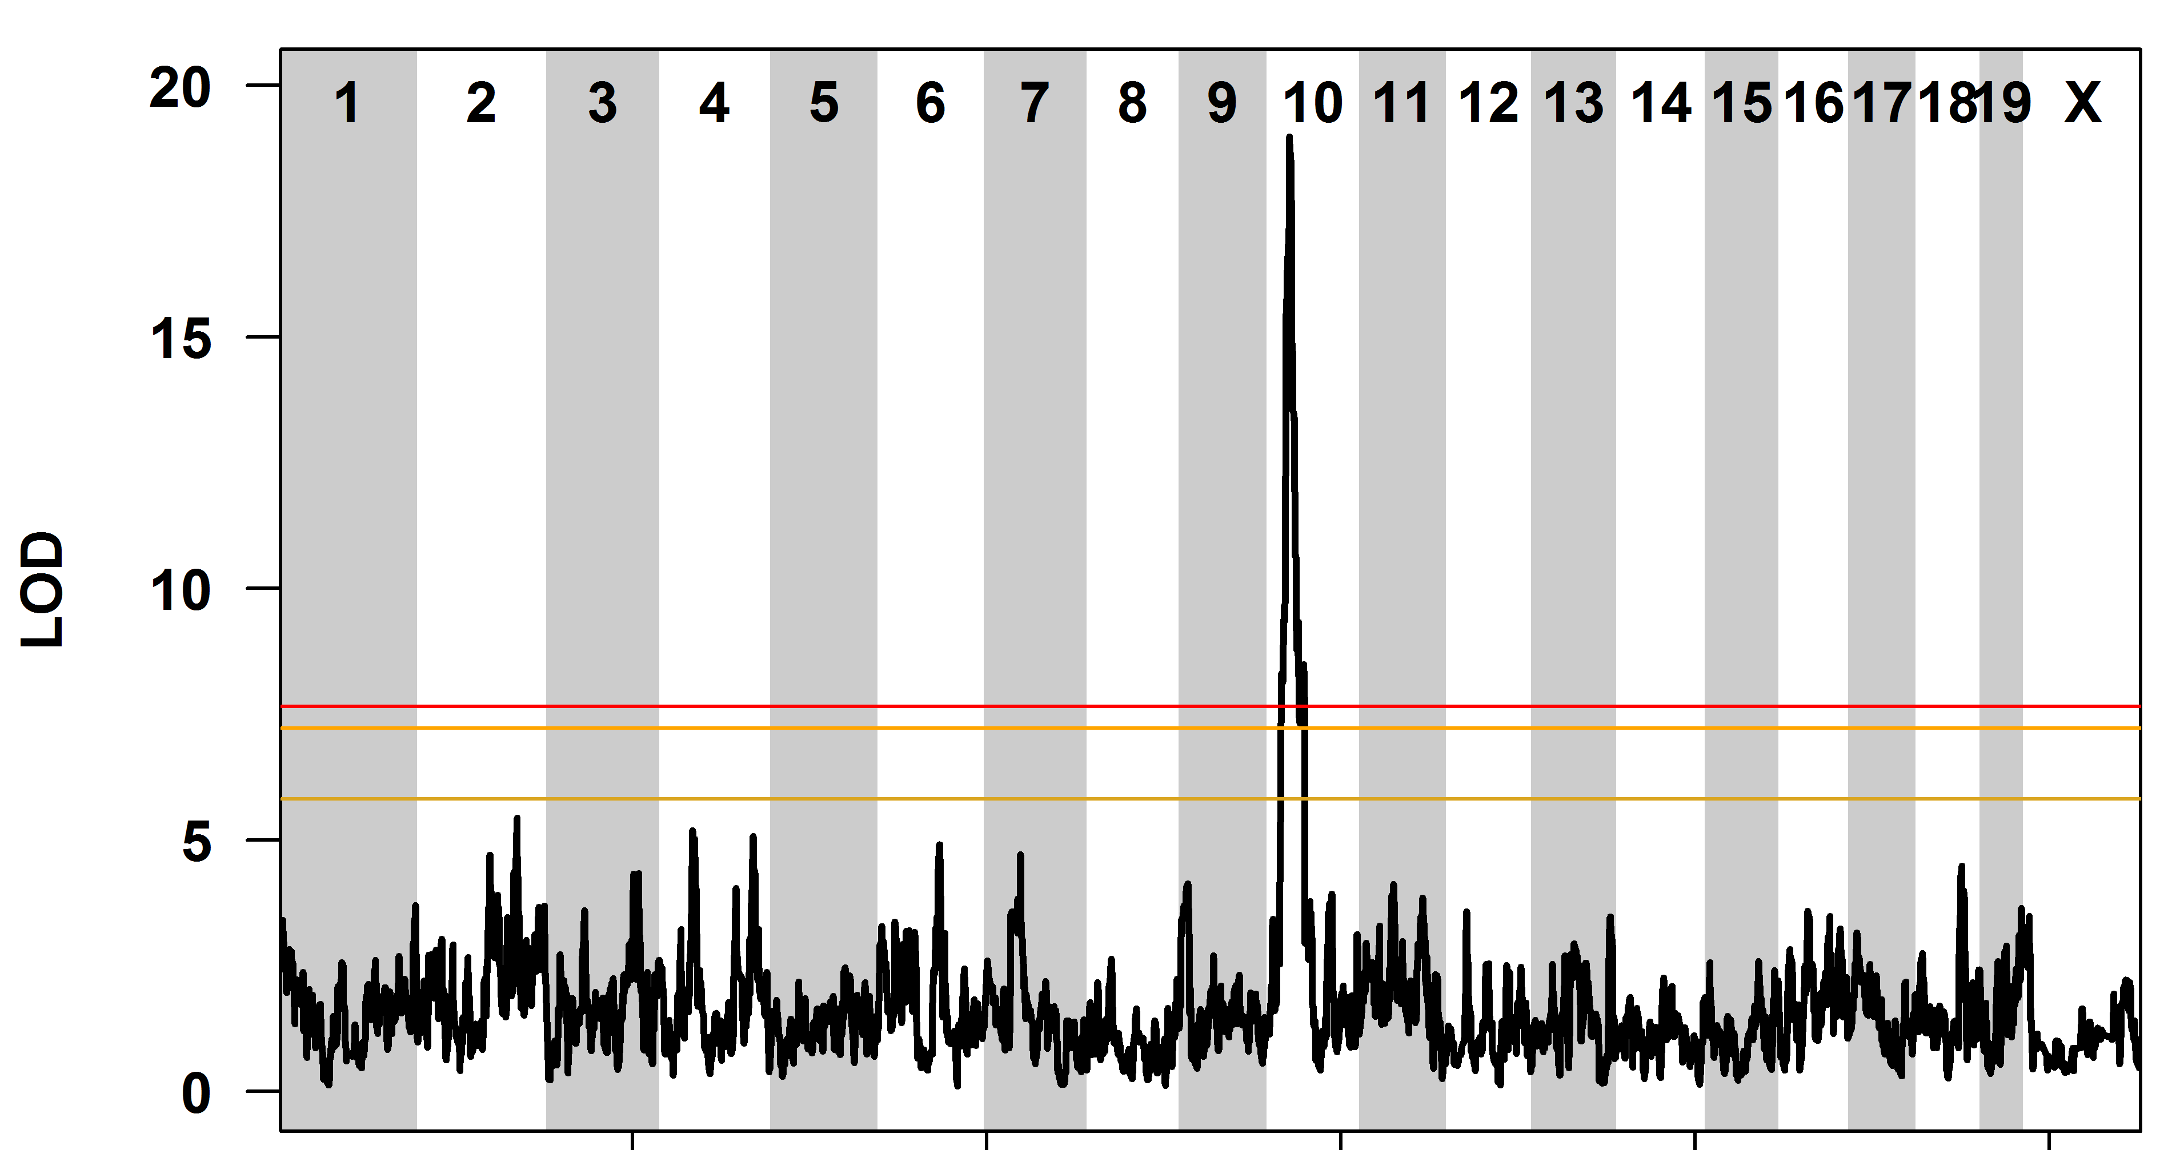
QTL Plot of Bone Marrow MN-RET

Slide 82
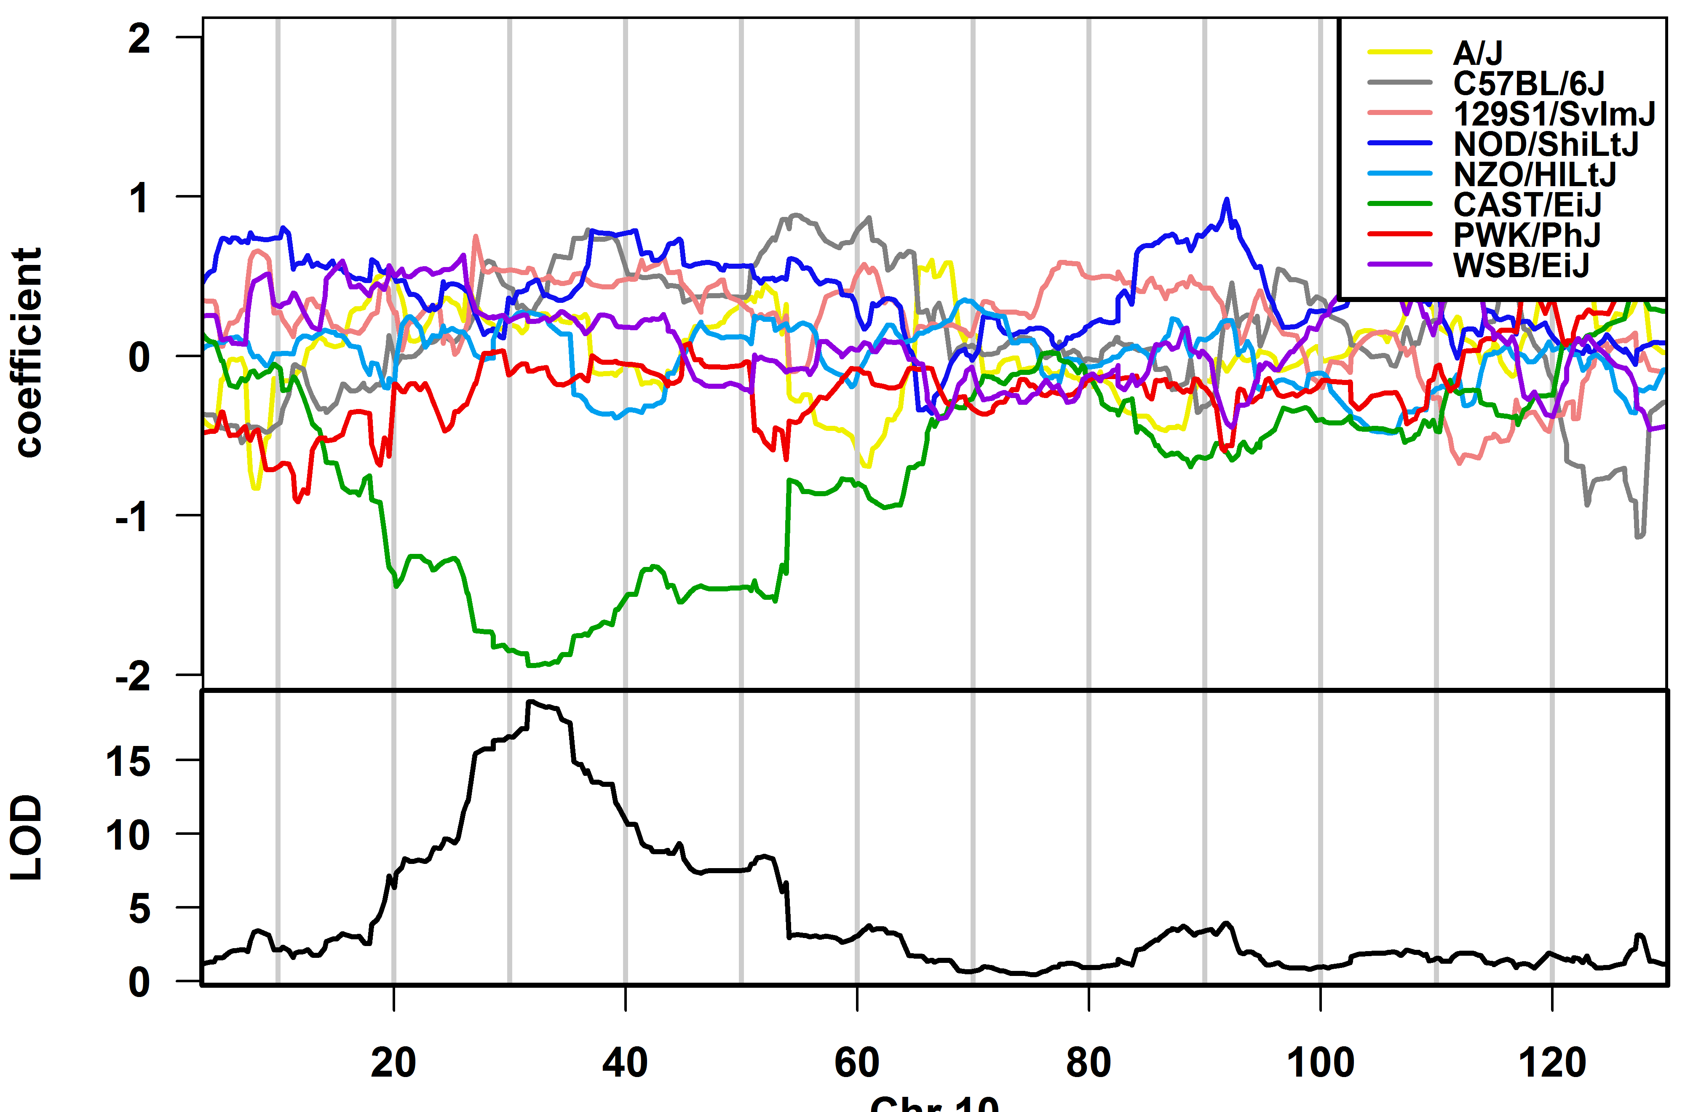
The CAST allele is protective
DNA
Damage
Chr 10

Slide 83
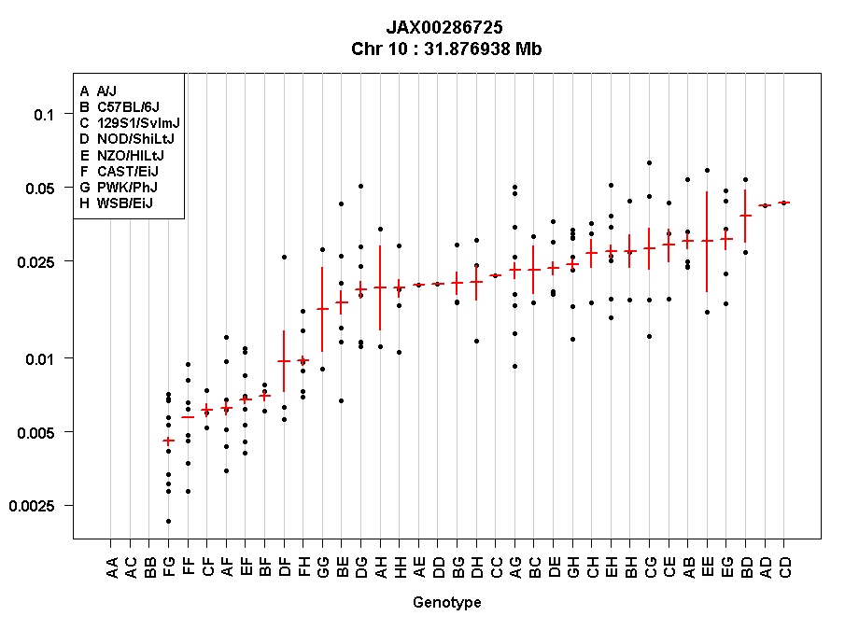
The CAST allele is dominant
Prop. MN-RET
Genotype

Slide 84
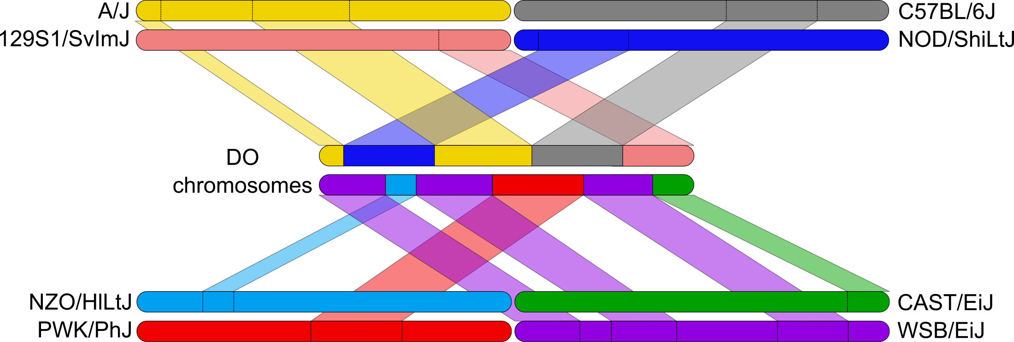
Association Mapping to narrow candidate gene list
Founders have been sequenced.
We have founder haplotypes for the DO.
Map founder sequences onto DO.
QTL map using smaller, three genotype model.

Slide 85

Association Mapping to narrow candidate gene list
Founders have been sequenced.
We have founder haplotypes for the DO.
Map founder sequences onto DO.
QTL map using smaller, three genotype model.
DO | # | Geno
AB | 0+1 | 1
BB | 1+1 | 2
AC | 0+0 | 0
BE | 1+1 | 2
DE | 0+1 | 1
One Sanger SNP
A | B | C | D | E | F | G | H
0 | 1 | 0 | 0 | 1 | 1 | 0 | 0
0
1
2

Slide 86
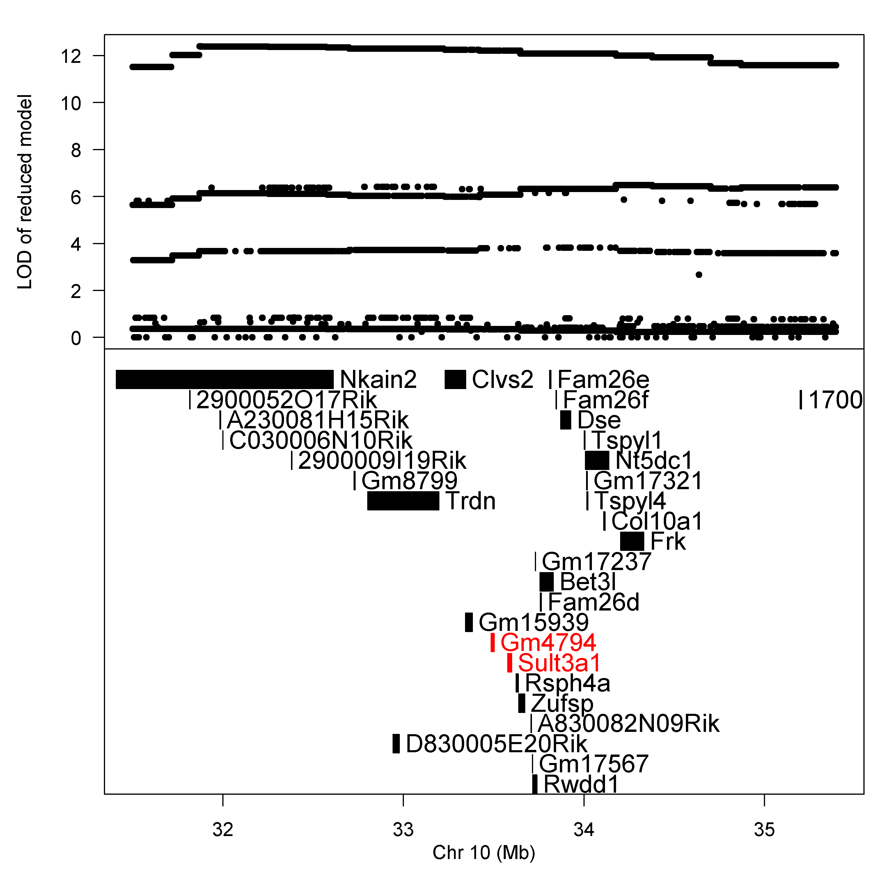
Sult3a1 and Gm4794 are sulfotransferases

Slide 87
Sult3a1 and Gm4794 have high expression in CAST livers
http://cgd.jax.org/gem/strainsurvey26/v1

Slide 88
The CAST allele of Sult3a1 & Gm4794 is more highly expressed than other alleles
French JE, et al., Env. Health Persp., 2015

Slide 89


CAST/EiJ has a copy number gain of sulfotransferases
http://www.sanger.ac.uk/sanger/Mouse_SnpViewer/rel-1303
Sult3a2
Sult3a1
http://ensembl.org

Slide 90

CAST/EiJ has a copy number gain of sulfotransferases

Slide 91

Hypothesis
Sulfate conjugation leads to excretion
Metabolite produces ROS
http://www.crios.be/Benzene/

Slide 92

Hypothesis
Mice with other allele at Chr 10 QTL
Active metabolites
Bone Marrow
Liver
DNA Damage
Less excretion
Mice with CAST/EiJ allele at Chr 10 QTL
Active metabolites
Bone Marrow
Liver
Less DNA Damage
More excretion

Slide 93
Summary
QTL mapping studies generate testable hypotheses.
i.e. Gene X affects phenotype Y.
Benzene-induced hematotoxicity is affected by a dominant, protective CAST allele.
CAST carries a duplication of a pair of sulfotransferases that increases constitutive liver expression.
Sulfation of benzene metabolites is a plausible detoxification mechanism.

Slide 94
Setup for Workshop
QTL Mapping Lesson Setup
https://smcclatchy.github.io/mapping/setup/
Download and install most recent versions of:
R
Rstudio
Follow instructions for installing external software libraries for R.
Download data files at bottom of page.
Main Lesson for next Tuesday:
https://smcclatchy.github.io/mapping/13-qtl-in-do/
I’ll be here this coming Thursday as well.

Slide 95


Acknowledgements
The Jackson Laboratory
Gary Churchill
Bob Braun
Elissa Chesler
Karen Svenson
Steven Munger
Narayanan Raghupathy
Al Simons
Kwangbom Choi
Anne Greenlee
Joel Graber
Steve Ciciotte, Lisa Somes,
Doug Hinerfeld / Sandy Daigle/ Sonya Kamdar
UNC-CH
Fernando Pardo-Manuel de Villena
Daniel Pomp
Leonard McMillan
Catherine Walsh
Cheng-ping Fu
Andrew Morgan
Univ. of Wisconsin
Karl Broman
Univ. of Chicago
Abraham Palmer
Riyan Cheng
NIEHS
John E. French
Kristine Witt
Daniel Morgan
Grace Kissling
Keith Shockley
ILS, Inc.
Kim Shepard
Leslie Recio
Alion
Herman Price

